Slide 2
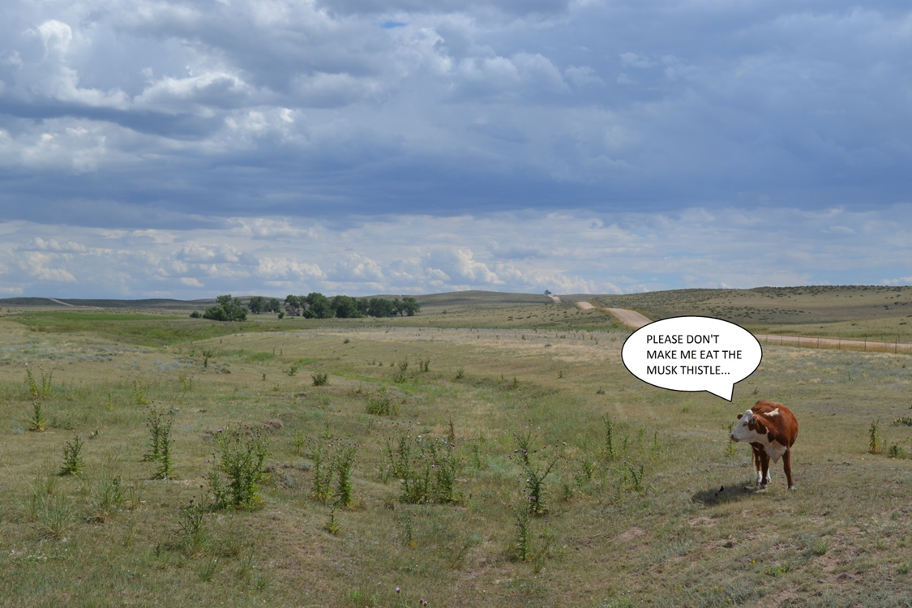
Upper Arkansas Cooperative Weed Management Area
November 5, 2014

Slide 3
Today’s Presentation
No Man’s Land 1541
“No man’s lands” of today
Land stewardship and an ecological perspective
Tools and measurements

Slide 4
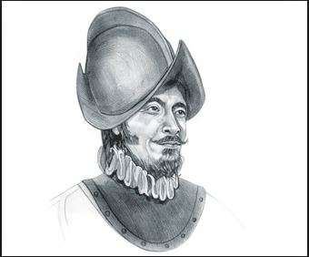
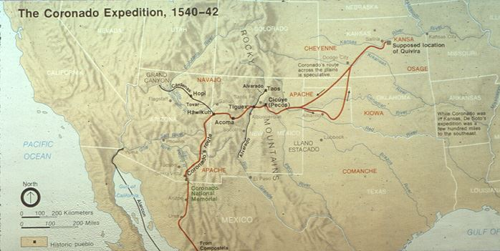
No Man’s Land, 1541

Slide 5
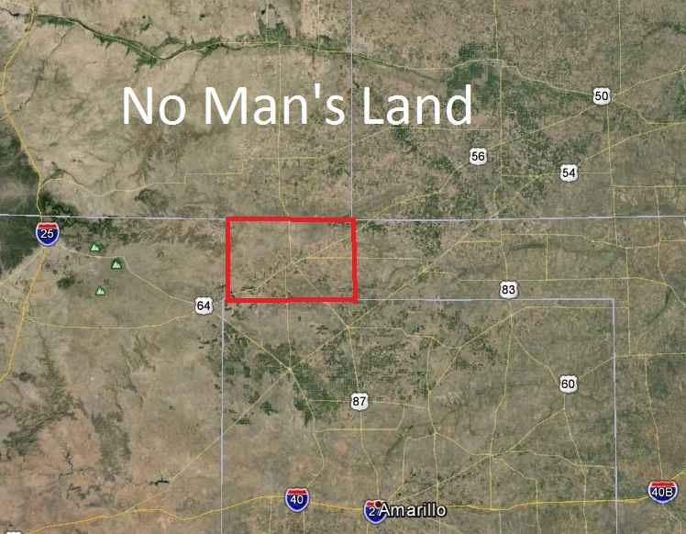
Colorado Department of Agriculture Noxious Weed Program

Slide 6
Germans, Russians and wheat
Late 19th century exodus from the Russian czar
“turkey red” winter wheat, along with . . .
Russian thistle
Farmers getting rich – for a while
First World War and the Turkish navy blockade
U.S. stepped in with price supports -- $2/bushel until the war’s end
Land/wheat became a commodity rather than a small-farm staple

Slide 7
Subsidizing wheat
Year | Land planted in wheat (acres) | Price per bushel | Cost to produce (per bushel)
1917 | 45 million | $2 | $.35
1919 | 75 million
1928 |  | $1
1930 |  | $.40
1930’s |  | $.24 - $.40

Slide 8
Vagaries of Climate
Years | Rainfall average
1910’s - 1920’s | 20”
Long-term average | 16”
1930’s | 8” – 12”

Slide 9
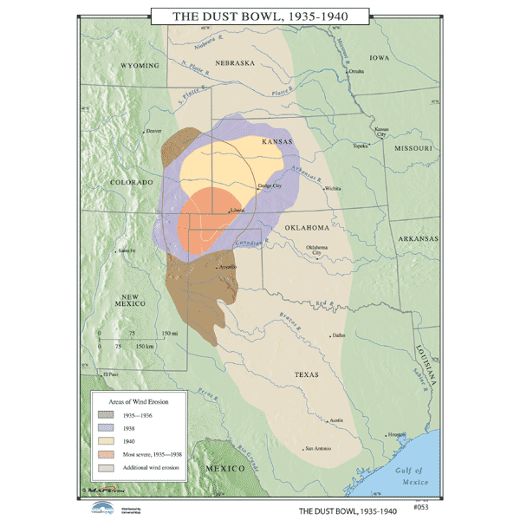

Slide 10
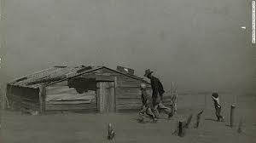
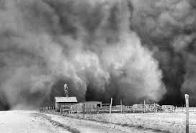
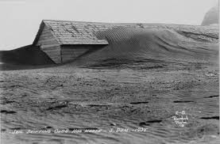
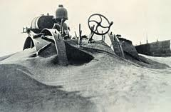
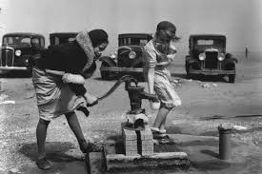
Colorado Department of Agriculture Noxious Weed Program

Slide 11
What have we learned from the Dust Bowl era?
Our experience with the land was very short
Economic incentives work – for better and worse
Grass keeps the soil from blowing away
Was this a failure of stewardship?
Not a familiar concept during westward expansion
. . . and, what does this have to do with noxious weed management today?

Slide 12
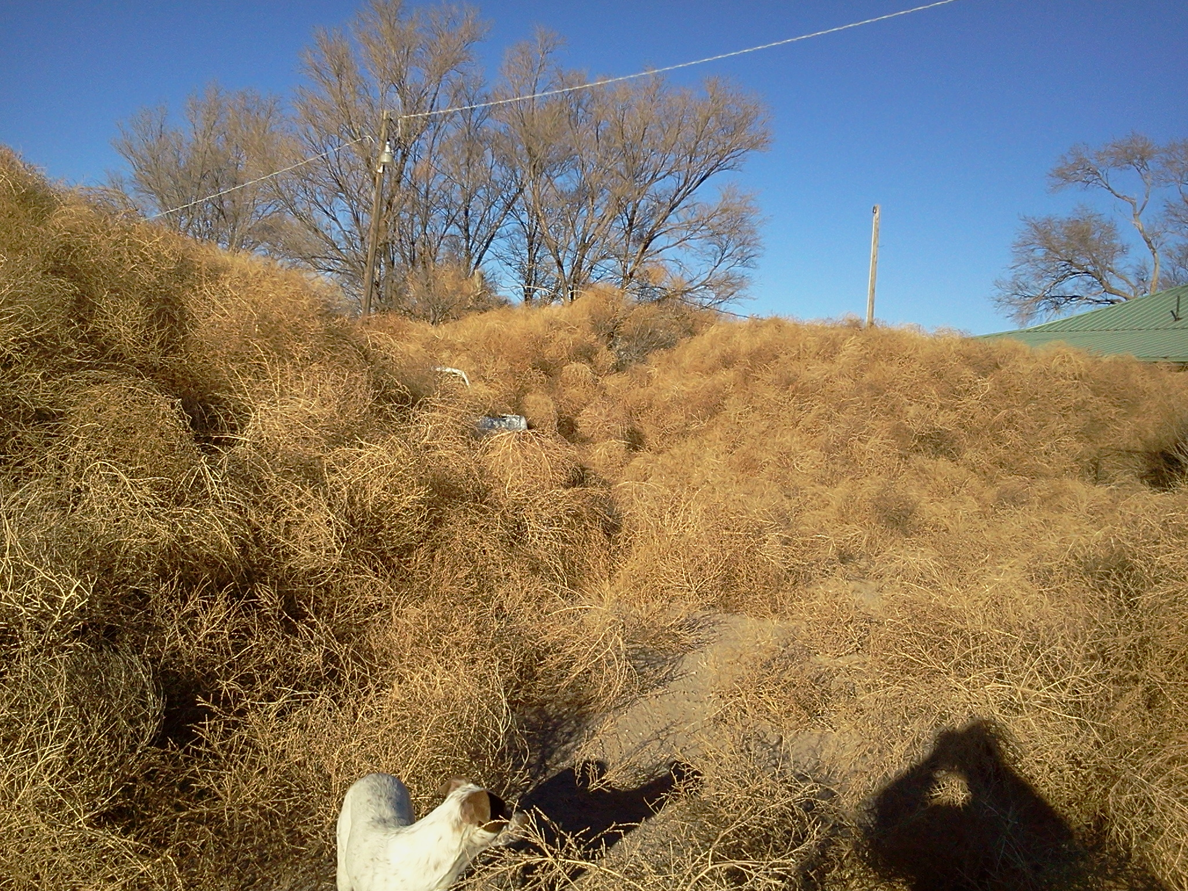

Slide 13
Extra-large or odd ROWs
No Man’s Lands today

Slide 14
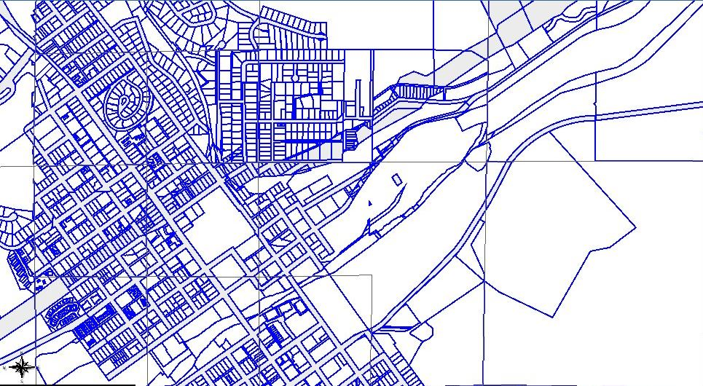

Slide 15
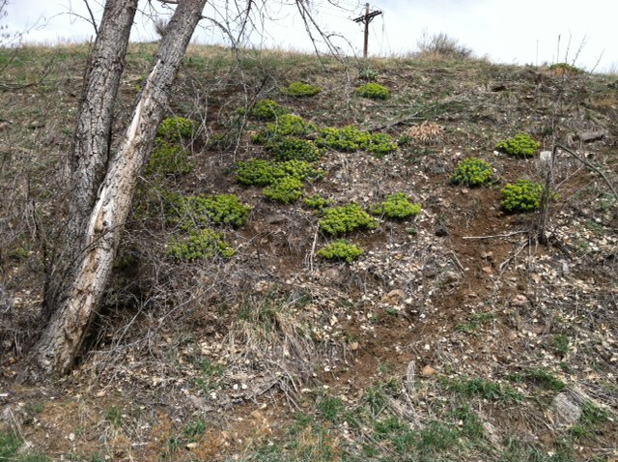
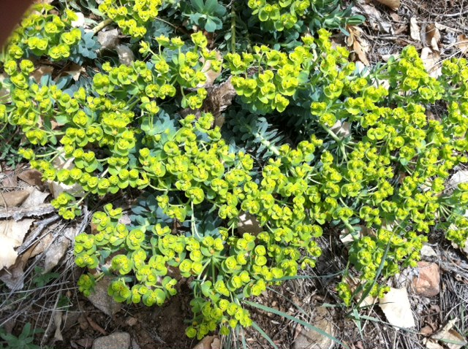

Slide 16
No Man’s Lands today
Extra-large or odd ROWs
Special districts (school, water, recreation, etc.)
Associations (HOAs, road associations)
Railroad beds
“Commons” areas

Slide 17
No Man’s Lands today
Abandoned or seasonally used properties
Property held for development
Other disturbed areas (mines, gravel pits, etc.)
Even municipalities
Killer terrain (special case)

Slide 18
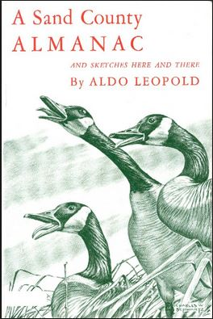
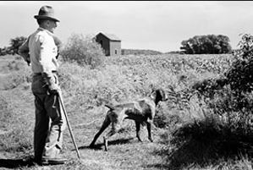
Land stewardship
Private lands
Public lands

Slide 19
Tools and Measurements
Tools, by definition, are largely “means”
We have a broad array of tools – the challenge (or science, or even art) is choosing the right one(s) at the right time, in the right place

Slide 20
Tools and Measurements
“Engagement” tools (recruitment)
On-the-ground tools
Strategic tools
Communication tools – reaching across the fence

Slide 21
In Sum
Healthy landscapes . . . Healthy habitats . . .
Invest in relationships – resolve No Man’s Lands by reaching across the fence
Anticipate the consequences of our management actions 2-3 steps out
Stewardship is a real challenge where land is a viewed as a commodity, but . . .

Slide 22
A few “laws and regs” things…
Weed Act rule regulatory review in 2015
WF and SPF RFPs
Rule amendment taking effect at year’s end
Legislative session

Slide 23
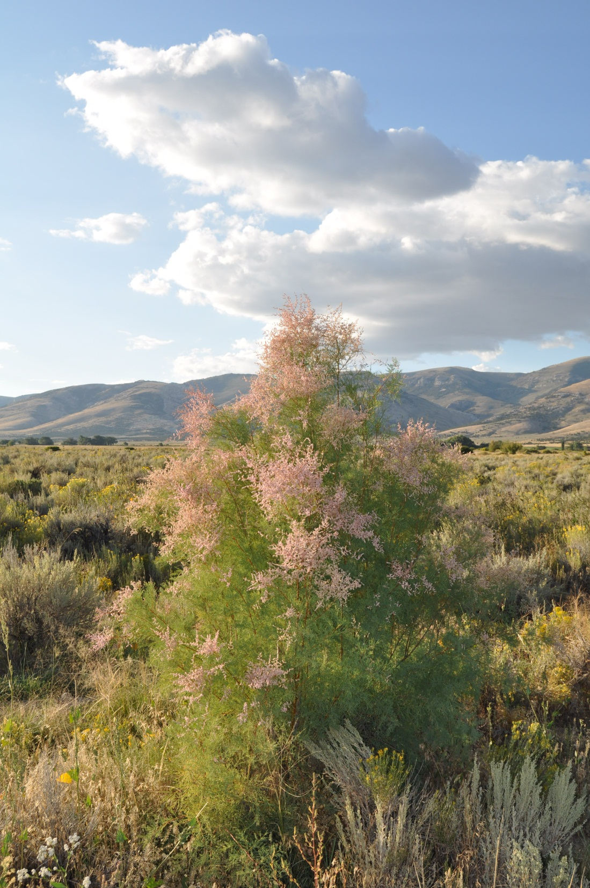
Thank you!
Steve Ryder
State Weed Coordinator
Colorado Department of Agriculture
(303) 869-9034 o
(303) 828-8329 c
steve.ryder@state.co.us

