Slide 1
Edrr Update Fall 2014
Patty York
EDRR Specialist
Noxious Weed Program
Colorado Dept. of Agriculture

Slide 2
Outline
Introduction to EDRR in Colorado
2014 Field Season
Rules changes
Hairy willow-herb (Epilobium hirsutum)
Garden loosestrife (Lysimachia vulgaris)
Mapping
Mobile Application
To come in 2015

Slide 3
Early detection & rapid response
Noxious Weed Program
Prevention/ Import Restriction
Early Detection and Rapid Response
Education
Control
Regulation
Notes:
EDRR is just one component of a noxious weed program. EDRR is the most cost-effective and environmentally friendly approach because it 1. doesn’t restrict trade or the movement of species, 2. only deals with species that have established free-living, self-perpetuating populations, 3. causes minimal and short effects on invaded habitat, regardless of control method, and 4. aims to restore the invaded habitat to a new balance.

Slide 4
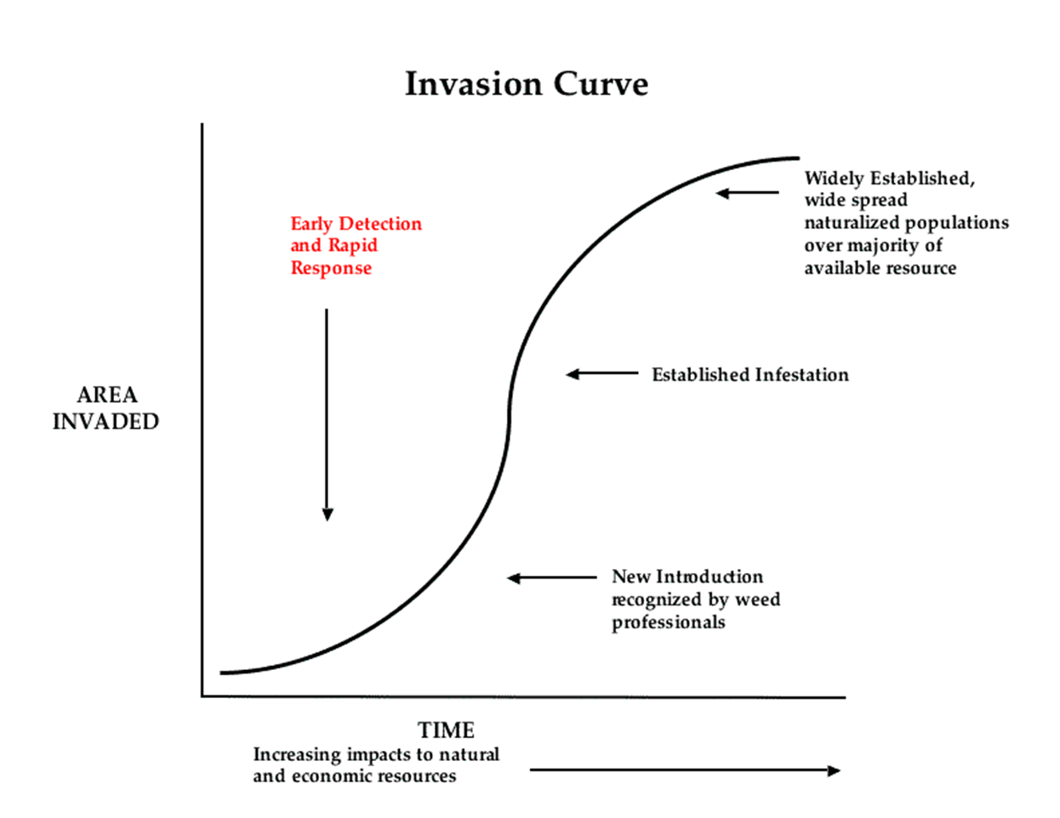

Slide 5
Components of EDRR
National System CO State System
Federal Interagency Committee for the Management of Noxious and Exotic Weeds (FICMNEW)
Detection and Reporting
Identification and Vouchering
Rapid Assessment
Planning
Rapid Response
Early Detection
Rapid Assessment
Rapid Response

Slide 6
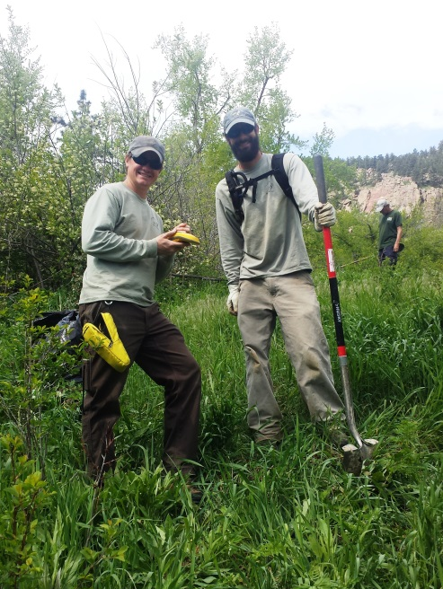
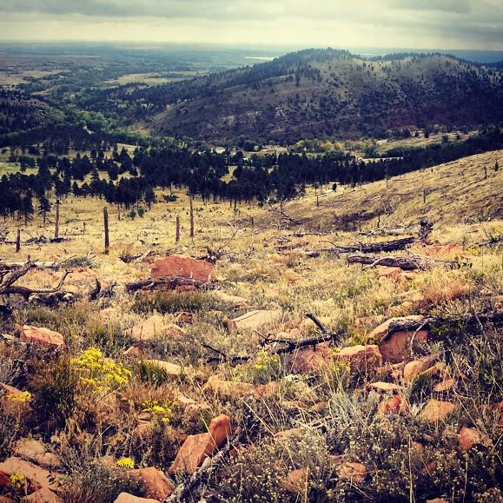
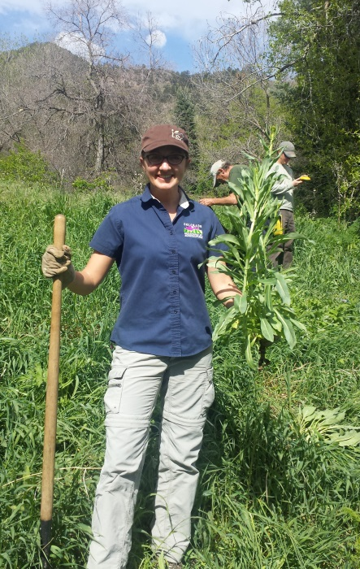
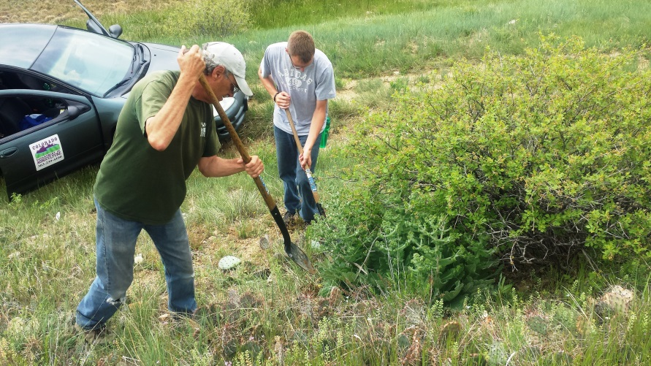
2014 Field season
New yellow starthistle and rush skeletonweed sites found
Some flood effects seen:
Loosestrife, Woad, and Mediterranean sage
Lots of new myrtle spurge projects and cost share programs in place!
Notes:
New Yellow Starthistle site on Hwy 96 near Pueblo
New Rush Skeletonweed site in Boulder foothills, about 2 miles due west of the other location
Purple loosestrife numbers were down along the South Platte River
Dyer’s Woad in Boulder was large and early this year
Mediterranean sage saw a few flushes in areas with higher moisture, but for the most part was about the same
Exponentially expanded myrtle spurge programs up and down the Front Range.
El Paso County worked a cost-share grant to help a ton of their property-owners with List A species

Slide 7
Outline
Introduction to EDRR in Colorado
2014 Field Season
Rules changes
Hairy willow-herb (Epilobium hirsutum)
Garden loosestrife (Lysimachia vulgaris)
Mapping
Mobile Application
To come in 2015

Slide 8
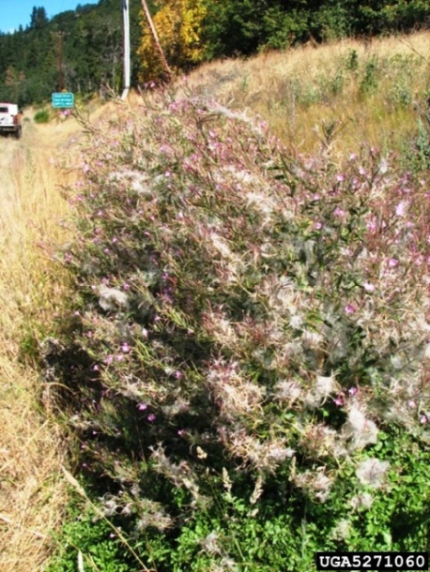
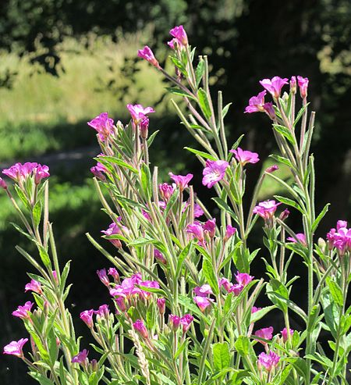
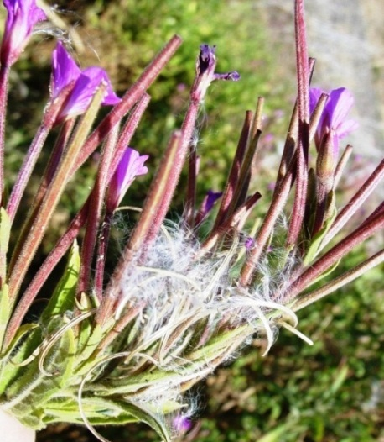
Hairy willow-herb (Epilobium hirsutum)
3-6 feet tall; perennial
Flowers ½ to 1 inch; blooms June to August
Stems are covered in soft hairs
Seeds have white silky tuft in long seedpod
Leaves are ½ inch wide, 2-4 inches long, opposite, lance-shaped with toothed edges
Reproduces primarily by rhizomes

Slide 9
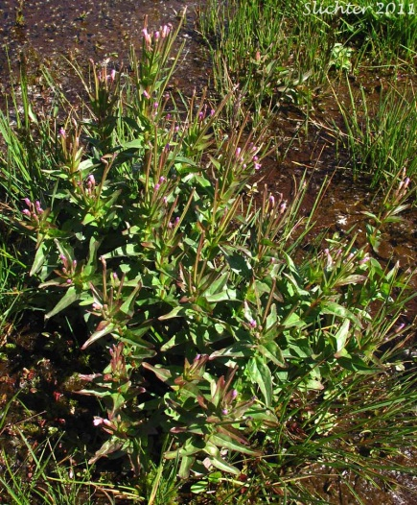
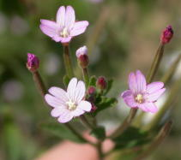
Fringed, Slender, or Northern Willow herb (Epilobium ciliatum)
perennial herbaceous wetland species
grows up to 5’ tall
thickly veined lance-shaped leaves may be up to 15 centimeters long toward base
foliage, stem, and inflorescence covered in bristly hairs and glands
regular, trumpet-shaped flowers have four petals so deeply notched they look like four pairs
flowers white to light purple or pink with dark veining
fruit is a narrow, hairy, four-chambered capsule up to 10 centimeters

Slide 10
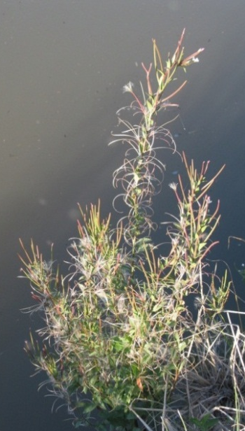
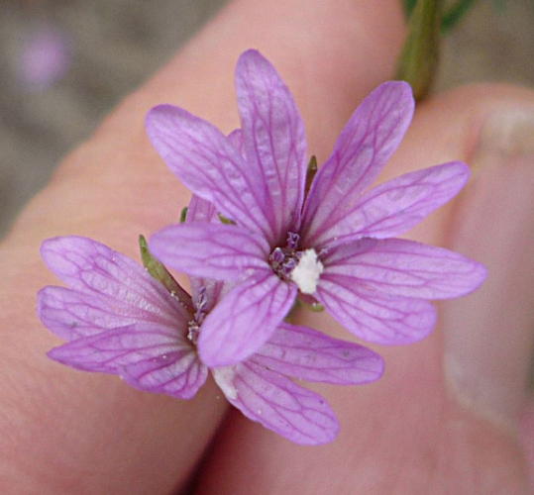
Tall, Tall Annual or Panicled Willow-herb or Tall Fireweed (Epilobium brachycarpum)
tall glandular, hairy annual herb occasionally reaching two meters in height
somewhat gangly and thin like an erect weed
narrow, curving, pointed leaves up to a few centimeters in length
flower has four petals which may be so deeply notched that they look like four pairs; generally light purple or pink, with darker veining
fruit is a capsule, 1 to 3 centimeters long

Slide 11
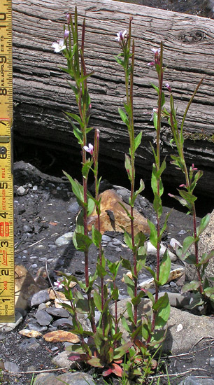
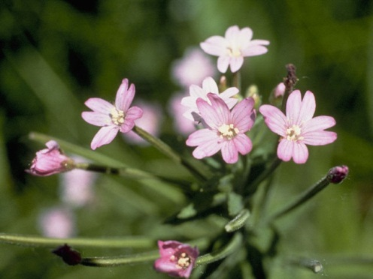
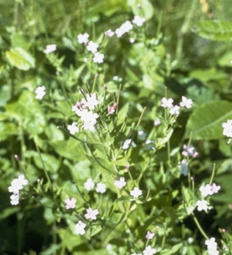
Hornemann's willowherb (Epilobium hornemannii)
flowers are tiny, pink/white/light-blue, and inconspicuous
very common and highly variable plant
"small and inconspicuous or no withered leaves" at flowering time
moist montane and sub-alpine trails, near ponds, and along irrigation ditches
common to have red stems and leaves in the spring and to return to these colors in the fall

Slide 12
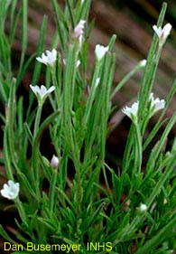
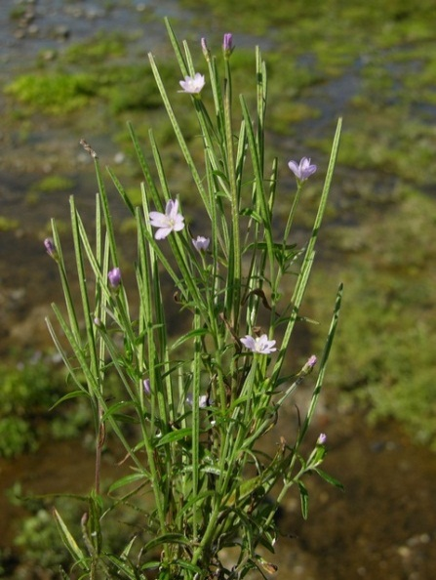
Hairy willow-herb vs. Natives
11 native species of Epilobium exist in Colorado
Range in elevation but mostly in wet places
Native flowers smaller/more delicate and less pink
Talus willow-herb
Epilobium clavatum
Fringed willow-herb (TE)
Epilobium ciliatum
Milkflower willow-herb (TE)
Epilobium lactiflorum
Bog willow-herb (TE)
Epilobium leptophyllum
Marsh willow-herb
Epilobium palustre
Epilobium brachycarpum
Tall annual willow-herb

Slide 13
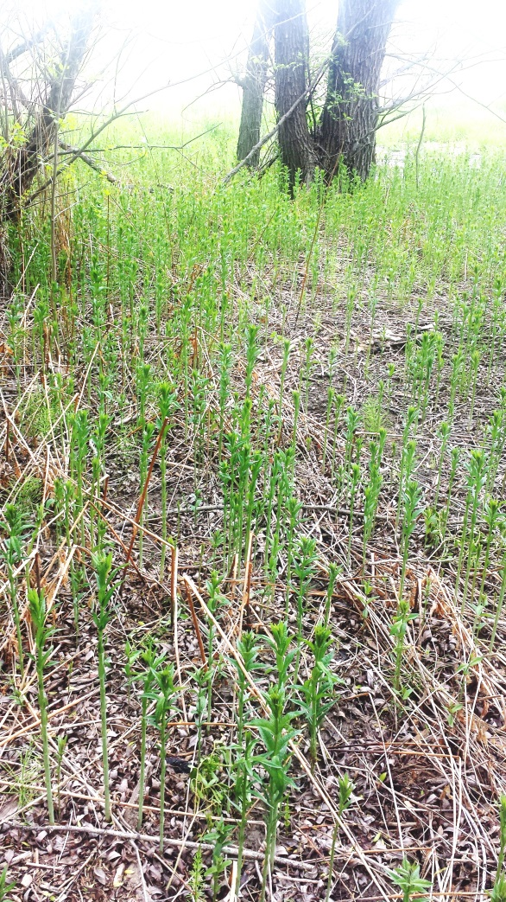
Garden loosestrife (Lysimachia vulgaris)
Known in riparian areas of Boulder
Was first identified in the Wonderland and Fourmile Canyon Creeks. Is now found along Boulder and South Boulder Creeks
Not sure how fast it’s spreading, but is definitely a monoculture-forming plant
Extra concern due to 2013 flooding

Slide 14
Outline
Introduction to EDRR in Colorado
2014 Field Season
Rules changes
Hairy willow-herb (Epilobium hirsutum)
Garden loosestrife (Lysimachia vulgaris)
Mapping
Mobile Application
To come in 2015

Slide 15
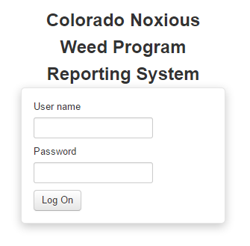
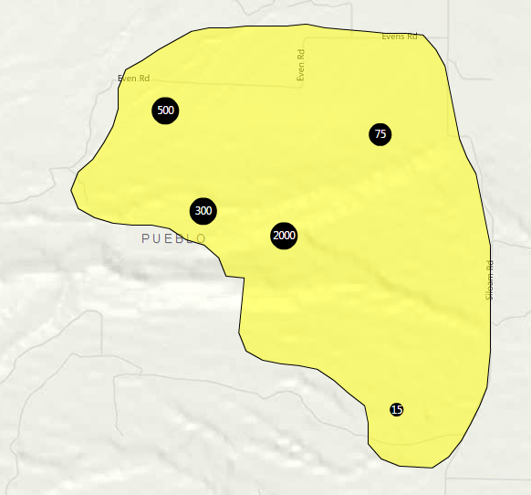
Mapping
Technician starting November 17th
maps.co.gov/CDA
All List A sites: polygon boundaries & point hotspots
Each site should have:
Site Name
Year Found
One Species
Be within one County
User_ID (firstname.lastname)
At least one hotspot!
Beulah
2008
Yellow starthistle
Pueblo County

Slide 16
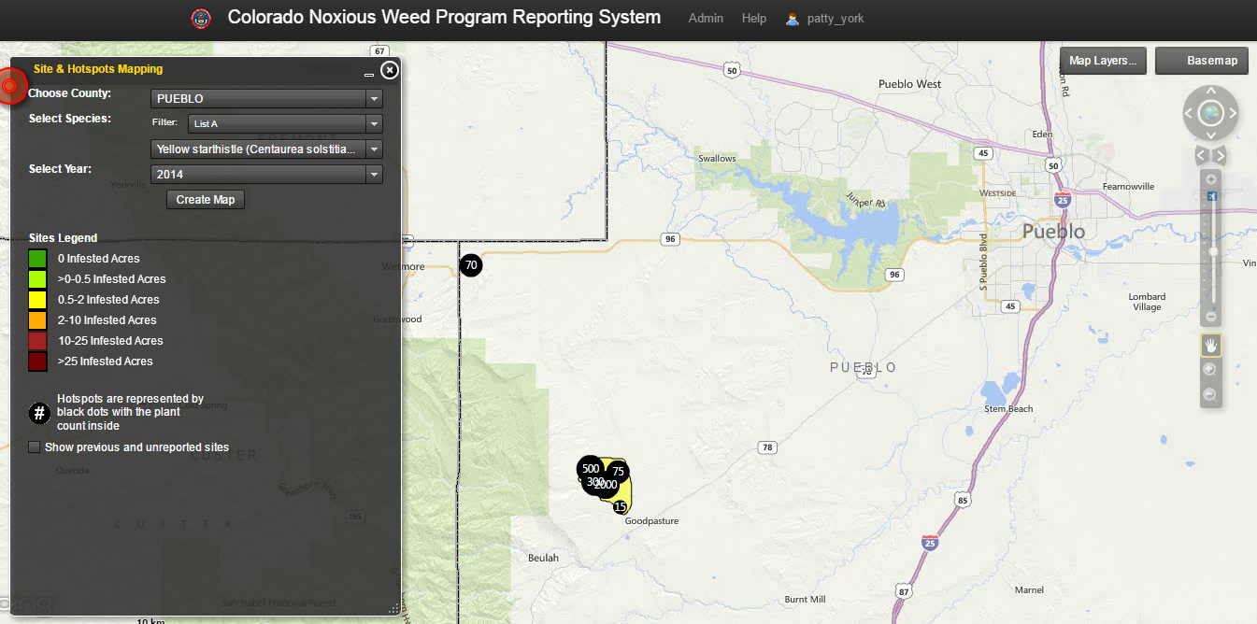
Mapping For List A sites (Yellow starthistle)

Slide 17
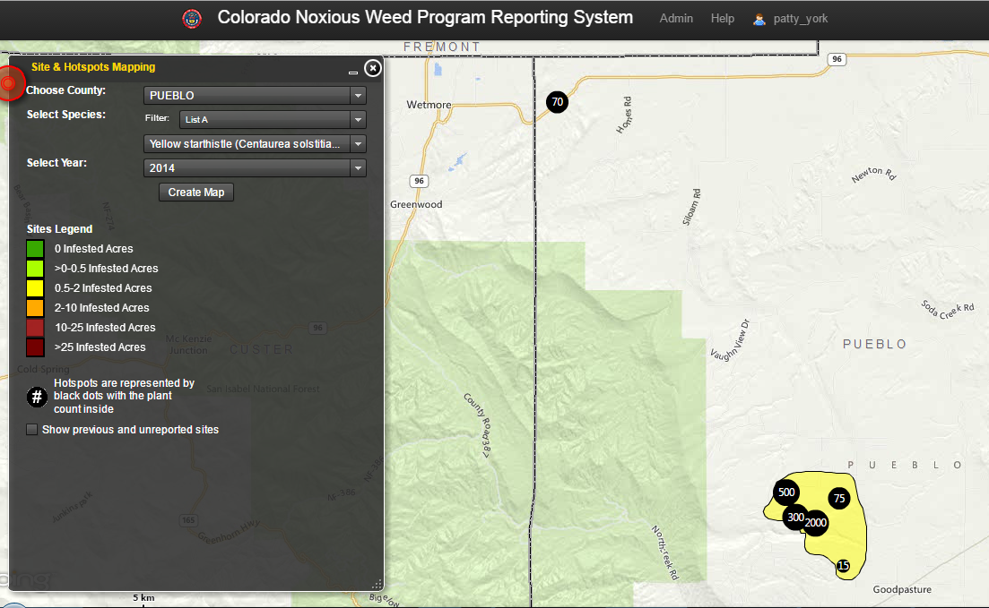
Mapping For List A sites (Yellow starthistle)

Slide 18
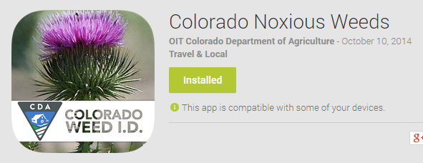
Mobile App

Slide 19
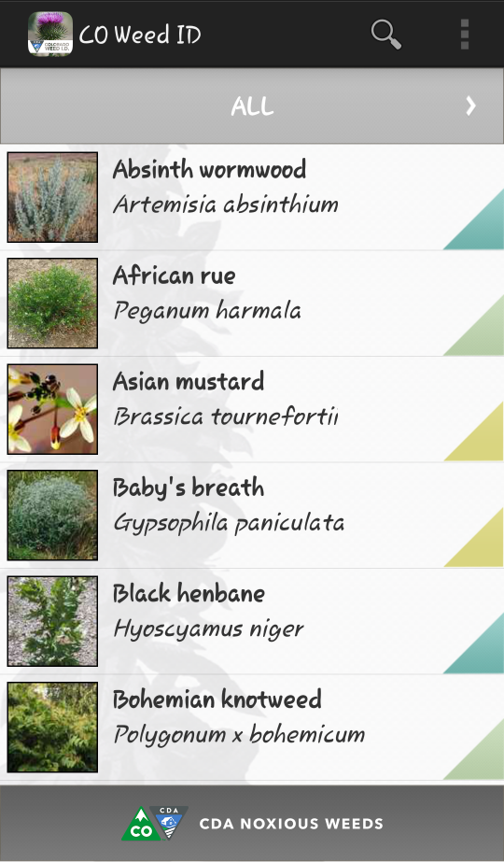
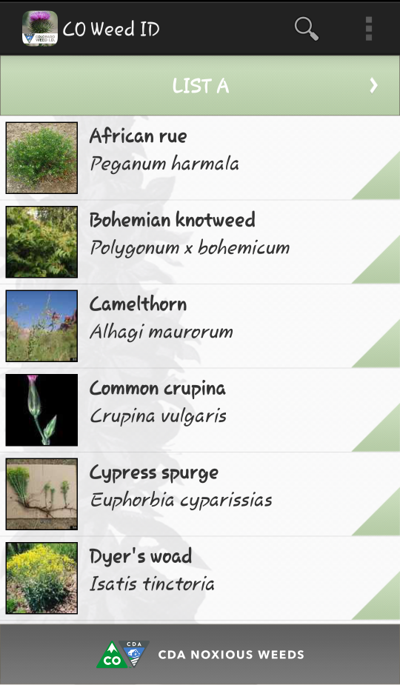
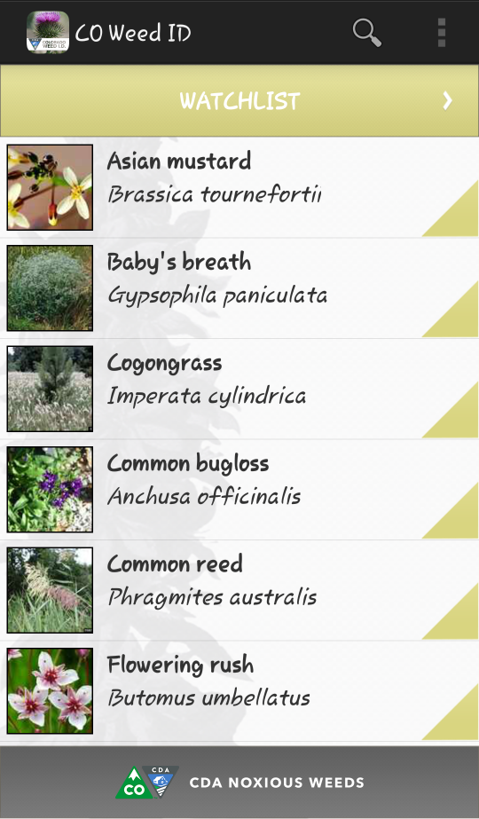
Mobile app

Slide 20
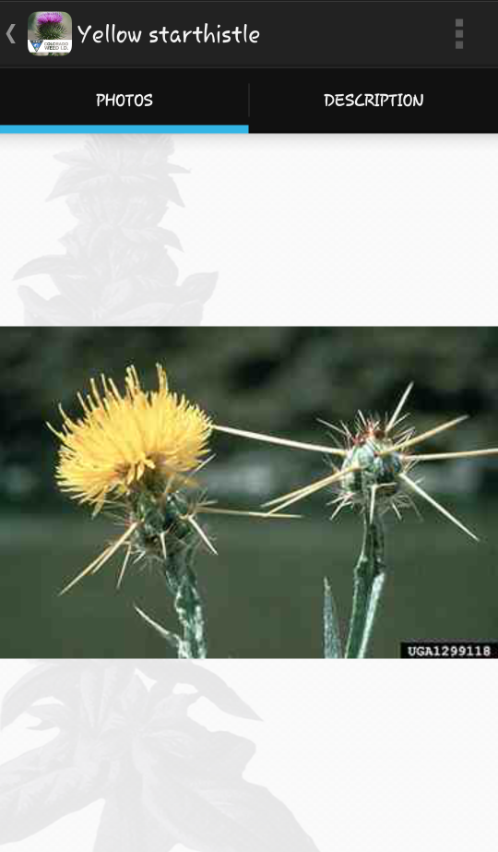
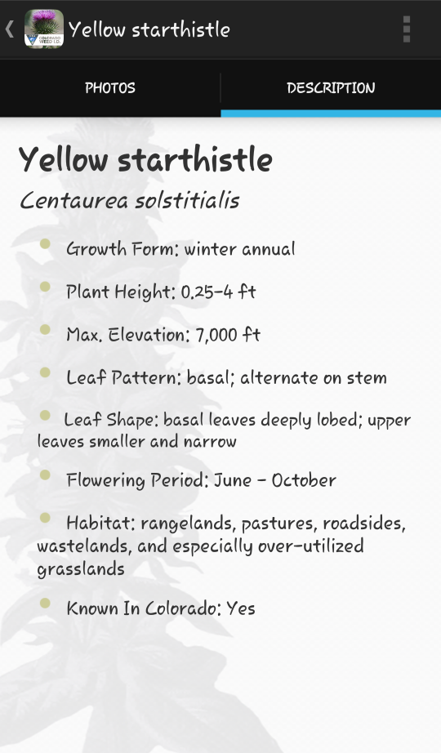

Slide 21
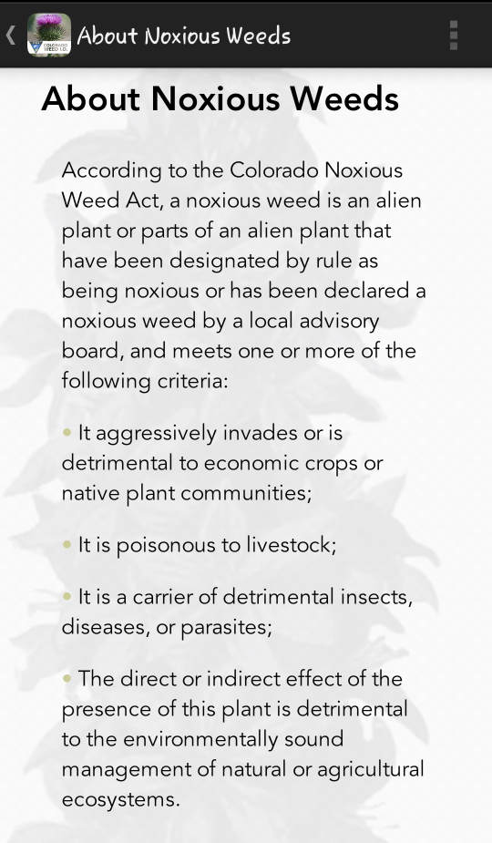
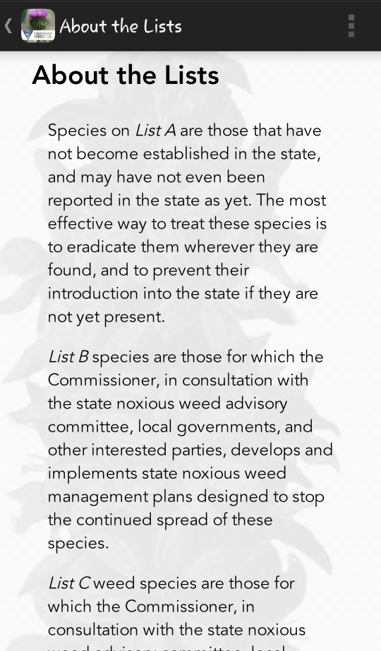

Slide 22
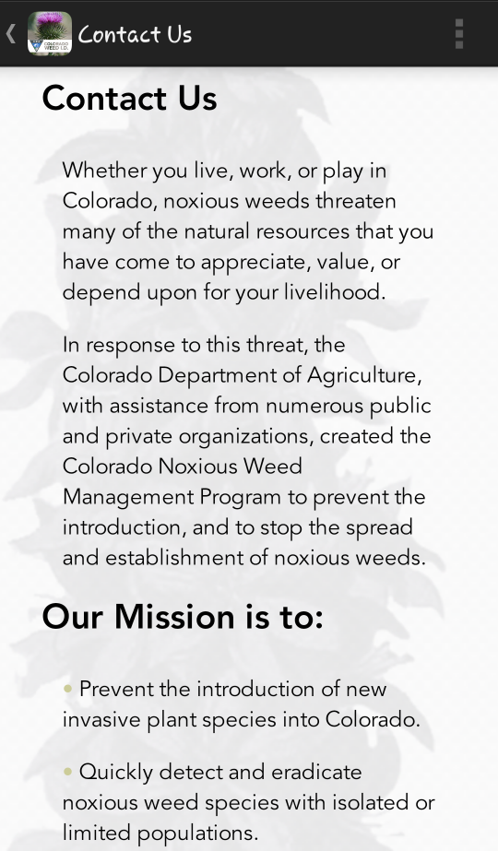
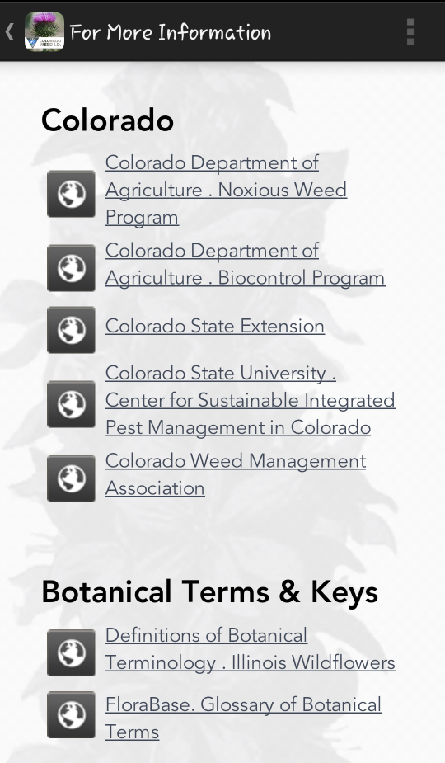

Slide 23
What 2015 has in store
Phase III of the Online Mapping System!
Printing ability
Exporting of data
Year-to-Year QQ data transfer
Submit comments and suggestions to patty.york@state.co.us
Traveling with the “A Team”
African rue
Elongated mustard
Meadow knapweed
Yellow starthistle
Purple loosestrife
A potential new List A species?

Slide 24
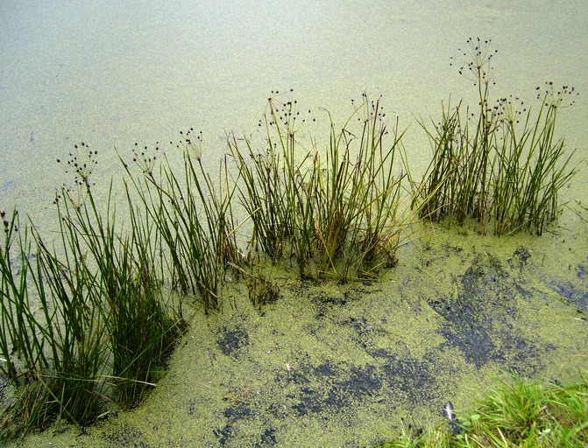
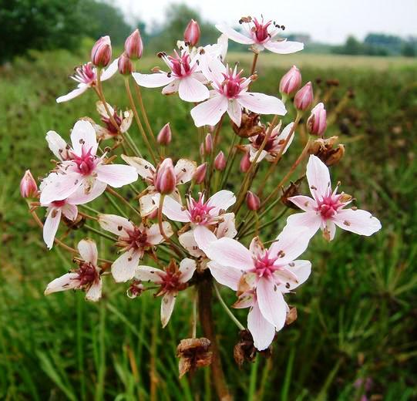
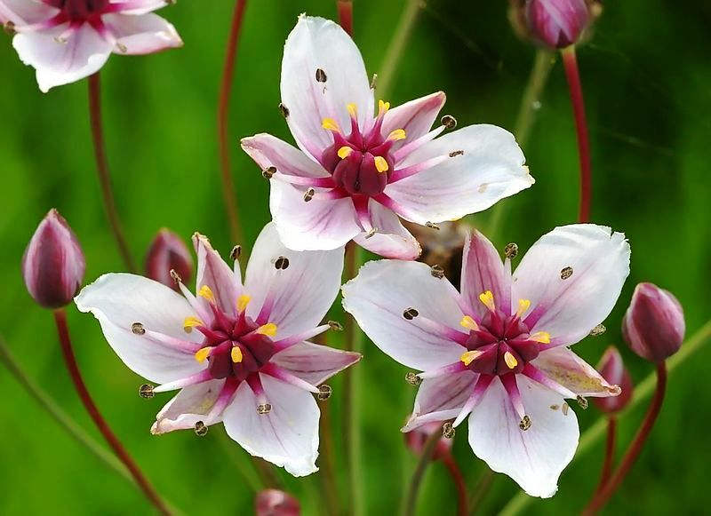
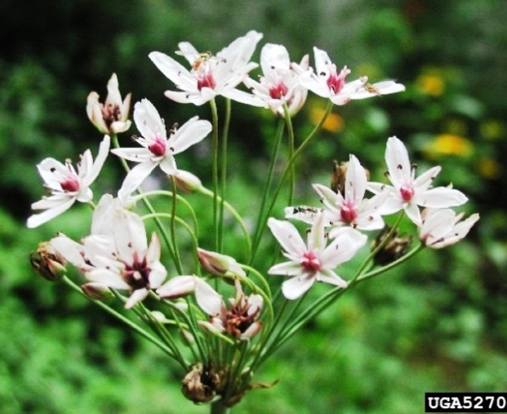
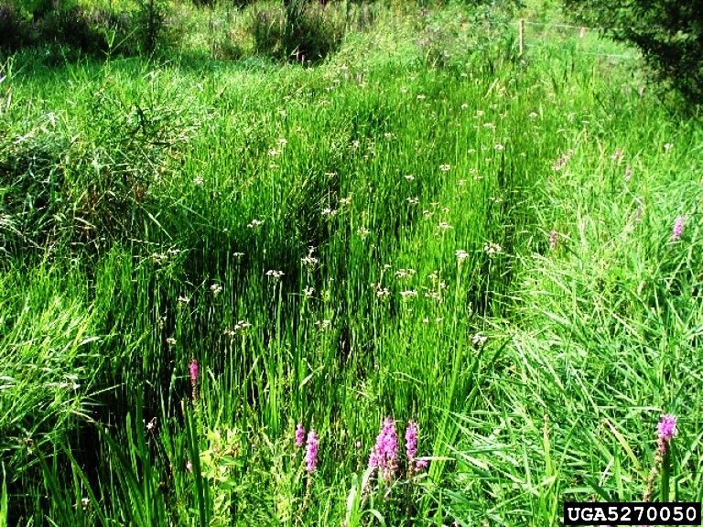
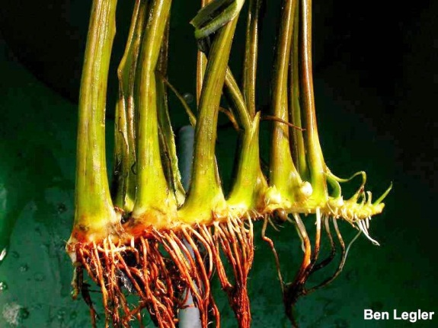
Flowering rush (Butomus umbellatus)

Slide 25
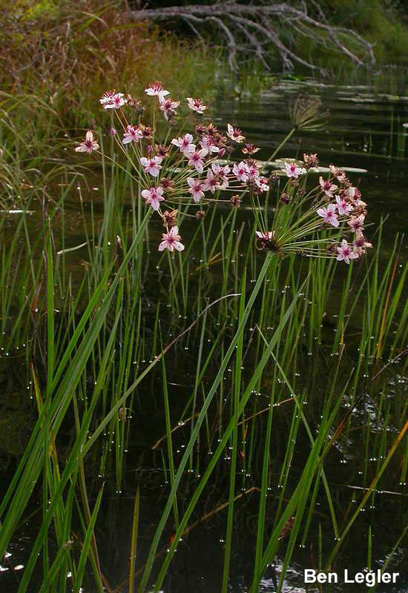
Flowering rush (Butomus umbellatus)
Perennial aquatic herbaceous plant
Grows up to 5 feet tall in shallow water
In deeper water, it grows submerged (no flowers)
Leaves sword shaped & triangular in cross-section
Showy pink flowers arranged in umbels
Reproduces from rootstock “bulb-lets” and by seed
Serious problem in Idaho; Expanding in Minnesota
No super effective treatment solution known
CSU is currently experimenting with FR
-Minnesota Department of Agriculture
Notes:
A site in Idaho has documented it outcompeting willows and cattails

Slide 26
Conclusion
Polygons and points for List A sites!
Hairy willow-herb: List A
CO Noxious Weed App!
Submit List A and Watch List information, online mapping suggestions, and potential field work for the “A Team” to: patty.york@state.co.us

