Slide 1
UACWMA
Laws & Regulations
Colorado Department of Agriculture
Nov 5, 2015
Jonathan Handy

Slide 2
Weed Control Categories
103 Ag Weed
106 Forest
107 Rangeland
108 Aquatic
109 Industrial Right of Way
206 Turf
401 Private applicator

Slide 3
Public Applicator
State agency, county, municipality, local government entity applying pesticides
RUPs – must register
GUPs only – may register
One+ QS in categories applied in
QS & CO links required
$50/yr
New: public GUP applicator personnel must be trained in core pesticide use

Slide 4
Individual Applicators
Qualified supervisor (more knowledge – exams; experience)
Certified operator (exams; no exp)
Technician (training)
Handler (WPS – Ag establishment)
Public applicator employee applying GUPs
Citizen applying GUPs – follow label
Federal employees & Indian reservations

Slide 5
Common Issues 2014-15
Records (79 occurrences)
Storage (71)
Equipment (65)
Posting (34)
Technician training (25)

Slide 6
Pesticide Applicator’s Act
(PAA)
35-10 CRS
PAA renewed 2015
Sunset 2023

Slide 7
Sunset stakeholders & facilitators
DORA & Legislature
Industry & CDA
Citizens
  All sat at the table & contributed
  --
  Legislature & Governor: Immediate decision makers

Slide 8
Major Sunset Considerations
Public interest & safety
Least restrictive regulation
Economic impact of regulation
Agency public service, efficiency & budget

Slide 9
What’s in the New Law?
Much is unchanged
Private applicator records must be kept two years, to harmonize with federal requirements (35-10-111)
Renewal applications must be received, not post-marked by due date, to facilitate elicensing (107 & 116)

Slide 10
What Else is New?
Public applicator employees must be trained in core pesticide use, not just RUP applicators (109)
Limited commercial applicator owner or designee must be trained in core pesticide use, not just RUP applicators (109)

Slide 11
More PAA Changes!
Finalized enforcement actions must be posted on the Internet within 30 days (124)
Pesticide advisory committee (PAC) expanded from 11 to 15 members (125)
  Two CDPHE reps, not one
  Beekeeper association rep
  One agricultural worker - WPS rep
  One organic ag producer
  An urban ag producer from the general public

Slide 12
Finalized Enforcement Actions
Posted on CDA Internet site:
  www.colorado.gov/agplants/pesticides
  At top of page

Slide 13
Proposed New Rules
308 Post-harvest potato pest control – new applicator category
Electronic notification

Slide 14
Proposed New Rules
Core Pesticide Use Training
Post-sunset PAA Requirement
Limited commercial applicator owner or designee must be trained in core pesticide use knowledge for many GUP applications (16.02)
Public applicator employees must be trained in core for many GUP applications (16.02)
Ready to use (RTU) & disinfectant/sanitizing pesticides excluded (16.03)

Slide 15
Core Training for Applications at
Schools, Day-Cares, Hospitals
All applicators must be trained in core prior to application of any GUP (16.03)
  Except disinfectants/sanitizers
  Including ready-to-use (RTU) GUPs

Slide 16
Core Pesticide Use Training
Options
Passing free CDA online course within last three years (16.04, 16.05)
Attending CDA-approved core courses (continuing education or other) within last three years (16.04, 16.05)
Passing a general CDA pesticide applicator exam (qualified supervisor, certified operator, private applicator) within last five years (16.04)
Holding a current QS, CO or PA license (16.04)
Training records must be maintained three years minimum

Slide 17

Questions??

Slide 18
EPA Proposed WPS Rule
40 CFR 170 Under FIFRA
Changes to agricultural worker protection standard (WPS)
To increase protections from pesticide exposure for ag workers & their families
CDA contact: Mike Rigirozzi
(303) 869-9059 & michael.rigirozzi@state.co.us

Slide 19
WPS Rule Timeline
Aug 2014 comment period closed
Nov 3, 2015 final rule publised
Jan 1, 2016 effective date
Jan 1, 2018 fully effective date

Slide 20
EPA Proposed C&T Rule
40 CFR 171 Under FIFRA
New certification & training (C&T) rule would likely require CDA law & rule change by 2018
Increased RUP applicator supervision & oversight

Slide 21
C&T Rule Highlights 1
Additional CECs for license renewal
50% or more of CECs in last 18 months before renewal
New high risk applicator categories
Increased exam oversight

Slide 22
C&T Rule Highlights 2
Increased tech training requirements
18 year minimum age for applicators
Stricter records requirements
Reciprocal licenses tightened up
Private applicators: exam security & license categories

Slide 23
CDA Elicense: AgLicense
On-line licensure, renewal, account updates
Pesticide products & PSR have migrated
  PSR will be accessible to commercial applicators online
Pesticide applicators to migrate fall 2015
  Online renewal notices
CEC
  On-line course submission
  ID cards – bar coded

Slide 24
CDA Moved May 2014
New location
  305 Interlocken Pkwy, Broomfield, CO 80021
Old location
  Kipling St, Lakewood

Slide 25
Other Current Topics
Drones & ag aviation
PERC devices
WDO inspection requirements from FHA and VA
Pesticides and marijuana, hemp
EAB & ornamental applicators

Slide 26
Thank You!
Jonathan Handy
Colorado Department of Agriculture
Pesticide Applicator Program Coordinator
305 Interlocken Parkway
Broomfield, CO 80021
303-869-9063
jonathan.handy@state.co.us

Slide 28
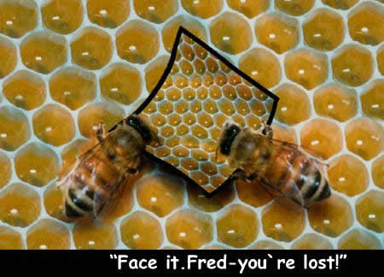
Pollinator Protection

Slide 29
Background
2006 N America & Europe: colony collapse disorder (CCD)
2008 Colorado: beekeeper complaints
2013 Oregon: dinotefuran bee kill
2013 EPA: pollinator protection on certain neonicotinoid labels

Slide 30
Neonicotinoids
Neuro-active insecticides
Similar to nicotine
Developed in 1980s & 1990s
Affected active ingredients: clothianidin, dinotefuran, imidacloprid, thiamethoxam

Slide 31
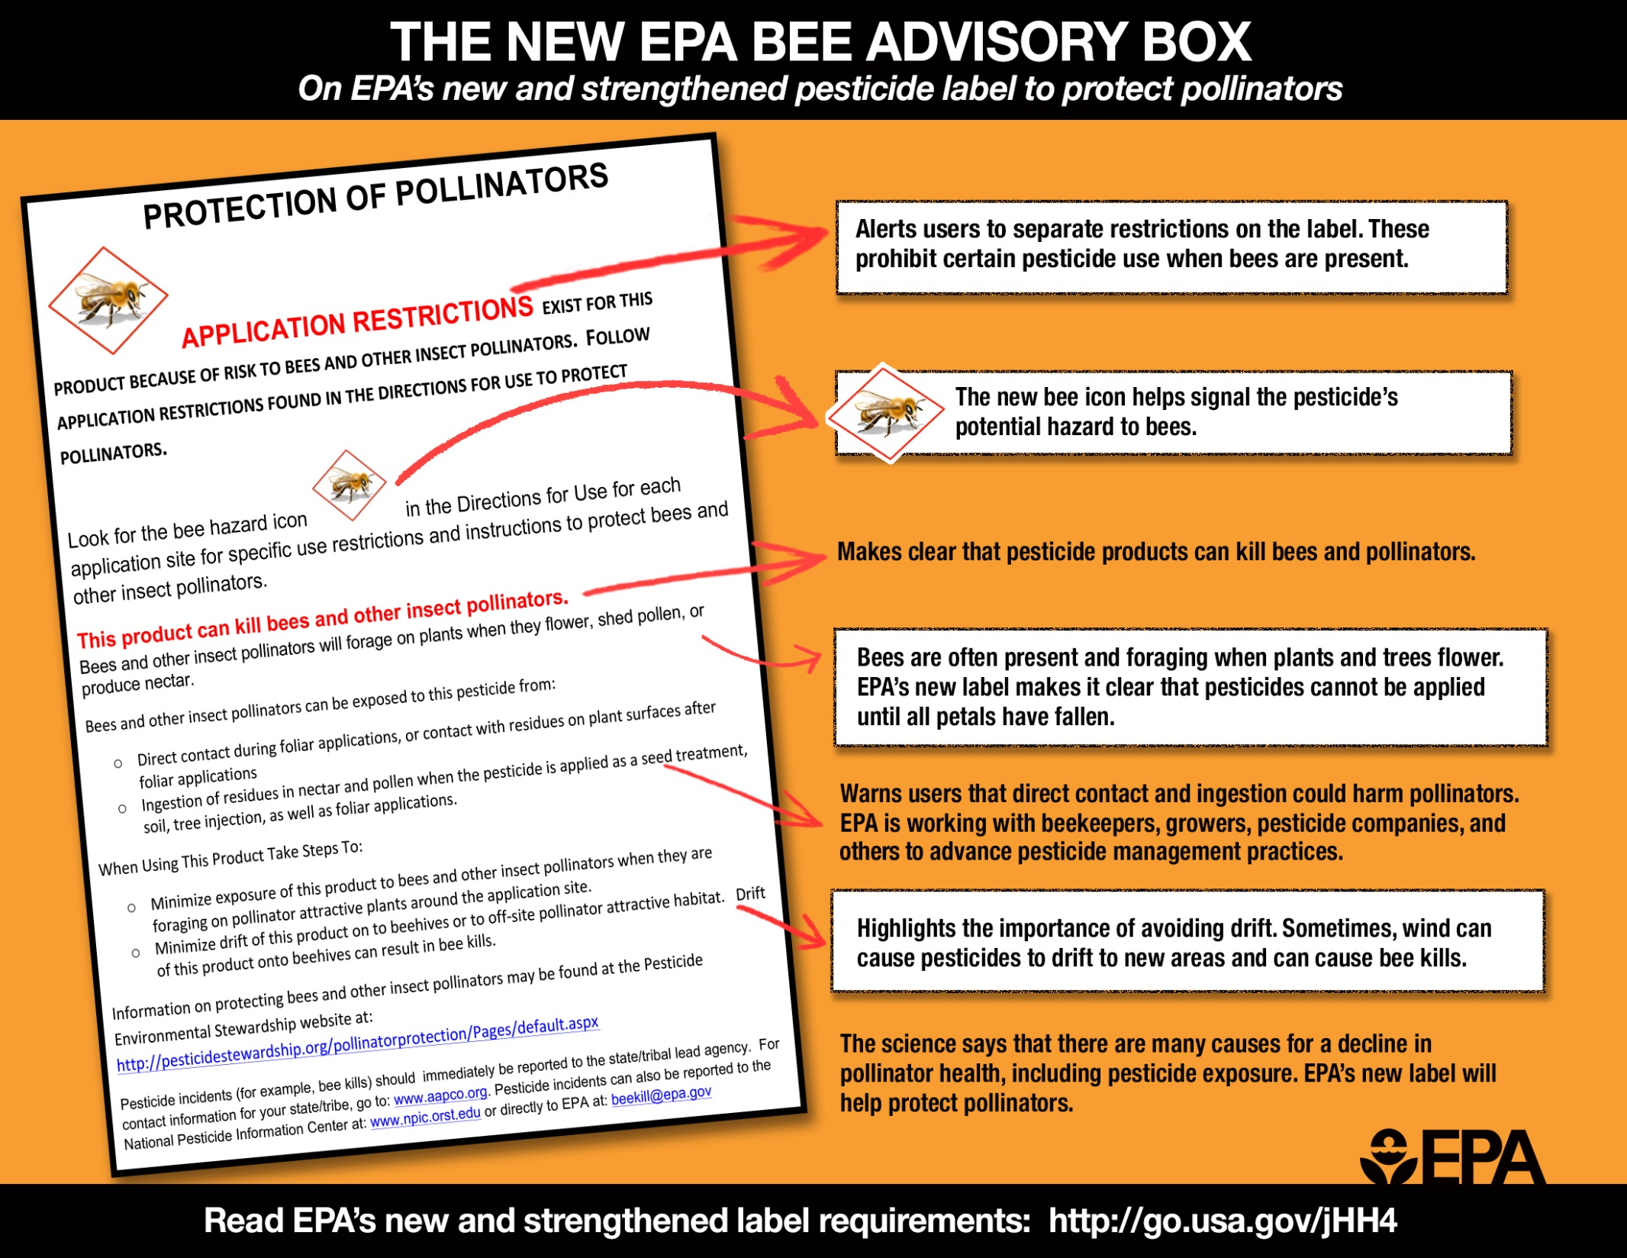

Slide 32
Directions for Use
1. For crops under contracted pollination services
2. For food crops and commercially grown ornamentals not under contract for pollination services but are attractive to pollinators
3. Non-agricultural products

Slide 33
Required for Non-Ag Products 1
Do not apply [product] while bees are foraging. Do not apply [product] to plants that are flowering. Only apply after all petals have fallen off.
More restrictive label language takes precedence

Slide 34
Required for Non-Ag Products 2
Foraging = actively visiting bees
“In the area” depends on weather, equipment, application method
After petals have fallen = pre-bloom or flowering is complete to extent bees are no longer foraging

Slide 35
Required for Non-Ag Products 3
Applications to turf & ornamentals
  When flowering plants with blooms are in the area being treated...
    Product may not contact blooms

Slide 36
AAPCO, ASPCRO & More…
Association of American Pest Control Officials (AAPCO)
State FIFRA Issues, Research and Evaluation Group (SFIREG)
Association of Structural Pest Control Regulatory Officials (ASPCRO)
State Lead Agency (SLA)

Slide 37
2014: Guidance for SLAs
Agricultural (AAPCO & SFIREG)
Non-ag (ASPCRO)
Label box is advisory; more restrictive label language takes precedence
EPA agreement

Slide 38
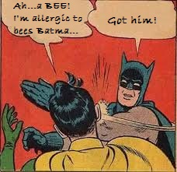
Pollinator Protection…

Slide 39
MP3s, PRs & Dockets…
Managed pollinator protection plan (MP3)
EPA pesticide registration notice (PR Notice) = policy notice
Docket = documents made available by an agency for public viewing, often for rule comment

Slide 40
2014-15 Presidential Initiatives
National pollinator health strategy
  Public/private partnerships
  Agency cooperation
  Research & education
  Increase and Improve Pollinator Habitat

Slide 41
2015 EPA Proposal
Major focus
  Labels for acutely toxic pesticide products
  Support for state MP3s
Noted
  Managed & wild bees
  Non-neonic acutely toxic pesticides
  Chronically toxic pesticides
  Public-private partnerships
  Reversing pollinator losses
Comment period closed Aug 29

Slide 42
2015 EPA Proposal
SFIREG Comment
Support for scenario-specific language
Bloom & site definitions
Residual time to 25% mortality (RT25) less than eight hours – blueberries, alfalfa, etc.
Environmental hazard section of label
Chronically toxic pesticides
Producer-beekeeper cooperation
MP3s

Slide 43
Cooperative Efforts & Hurdles
Beekeepers, Ag & Non-ag Industry, States & Associations, Citizens
  Pollinator protection plans
  Label language options, based on neonic labels
  Work groups – state, regional, national
  Hurdle: state laws

Slide 44
Flexible MP3s
Stakeholder involvement
Plan managed & tailored for state circumstances
One label size can’t fit all
  Site specific
  Crop specific

Slide 45
MP3 Scope
Commercial production is central, but...
Plan covers pollinators in general
Wild & managed bees
Hobbyists & commercial operations

Slide 46
MP3 Framework
Science-based
Advisory & required elements
Communication is key
  Grower
  Beekeeper
  Pesticide applicator

Slide 47
MP3 Highlights
Beekeeper Role
Communicate: register hive site
  Use Driftwatch or apiary program
  Protect hives during necessary applications to sites in bloom

Slide 48
MP3 Highlights
Applicator & Producer Roles
Communicate: use Driftwatch or apiary program
Notify beekeepers prior to application
Spray early or late
Spray at a low temperature

Slide 49
Current Plans & Workgroups
Several states have in place now
  Colorado has a plan
  MP3s
  Pollinator workgroups
  Best management practices (BMPs)
States without plans may be left only with what label language would allow
  Label language may restrict allowed applications to very specific parameters

Slide 50
Colorado’s MP3
Located on CDA Internet site
  www.colorado.gov/agplants/pesticides
  Colorado Pollinator Workgroup
  Operational Guidelines to Avoid Pesticide Related Bee Kills for Aerial Applicators and Beekeepers

Slide 51
Pollinator Protection:
Looking Forward
Applicator training & guidance on neonic use (AAPCO & ASPCRO)
Inclusion of pollinator protection language on all classes of pesticides acutely toxic to bees
CDA contact: John Scott (303) 869-9056 & johnw.scott@state.co.us

