Slide 1
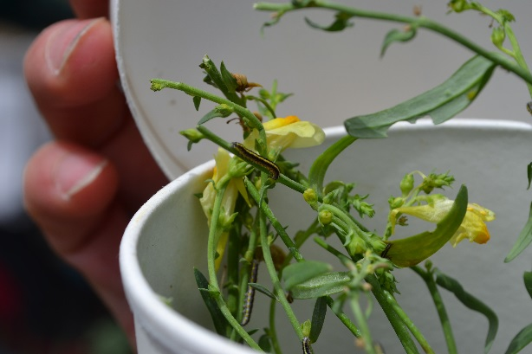
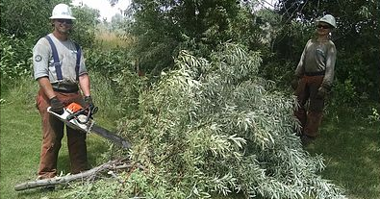
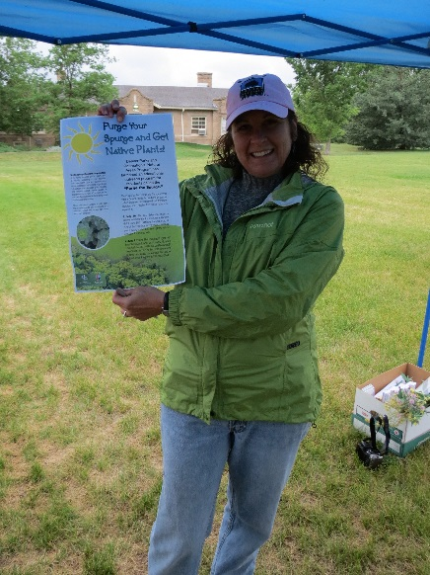
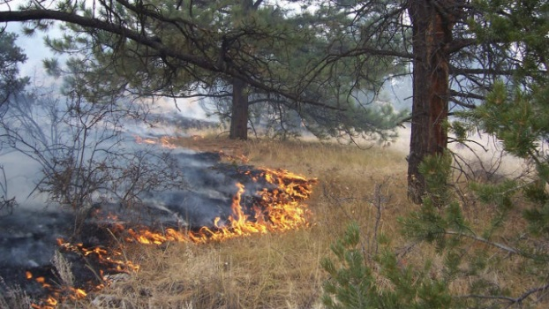
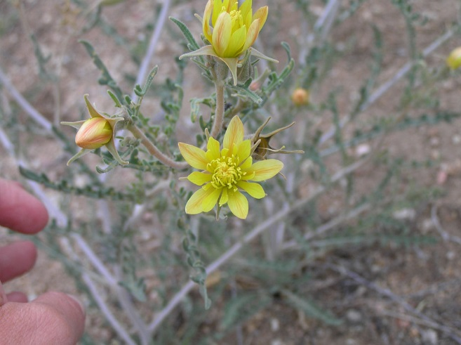
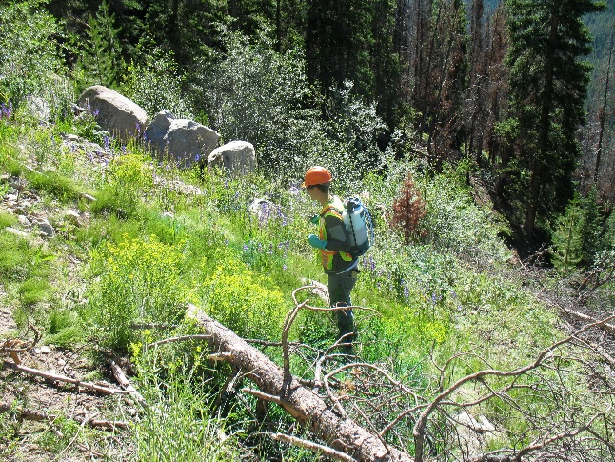
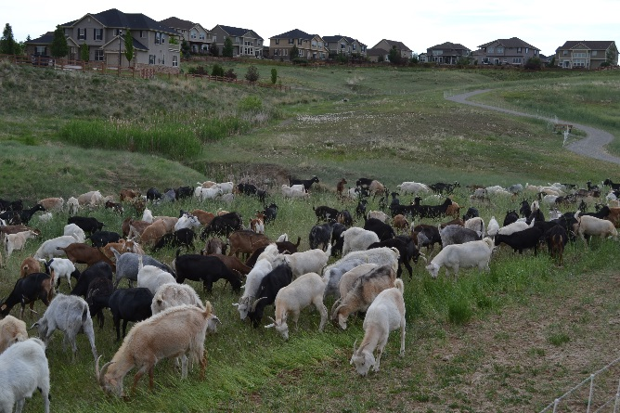
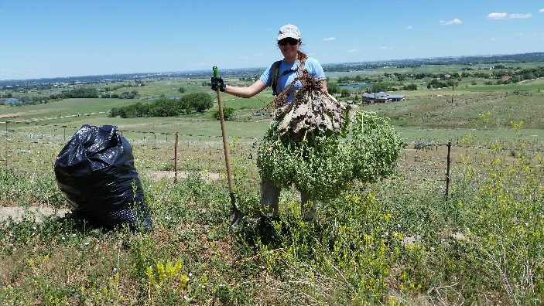

Management of Noxious Weeds and Special Status Species Conservation
Russian olive removal Rangely
Photo Credit Rocky Mountain Youth Corp
Mecinus janthinus Biocontrol Release Poudre River
Prescribed fire
Photo Credit Pike San Isabel National Forest
Purge the Spurge &
Buy Native Plants Event Denver
Mentzelia densa Royal Gorge stickleaf
Photo Credit CO Natural Heritage Program
Herbicide Application on Leafy Spurge Berthoud Pass
Goats Broomfield
Hand Removal of Mediterranean Sage Boulder

Slide 2
Protection
Preservation
Untouched
John Muir
National Park System
Conservation
Wise Use
Gifford Pinchot
National Forest System
Conservation
Bureau of Land Management
Domination
Full Extraction
Full Use
Private Property
Take
Definitions
Conserve: (ESA) To bring any endangered species or threatened species to the point at which the measures provided pursuant to this Act are no longer necessary

Slide 3
Laws
Migratory Bird Treaty Act of 1918
Bald and Golden Eagle Act of 1940
Endangered Species Act of 1973 (revised 1976)*
National Environmental Policy Act of 1974*
The North American Wetland Conservation Act 1989
Laws, Regulations, Policies Directives to
on-the-Ground Decisions & Projects
Regulation
16 US Code Chapter 36 Forest and Rangeland Renewable Resource Planning (Federal Register)
Policy Directives
FSM 2070 Vegetation Ecology
Forest Service Manual 2670 Threatened, Endangered and Sensitive Plants and Animals (2005)
BLM Manual 6840 Special Status Species Management (2008)
Planning or Project Decision Document
BLM Vegetation Treatments Using Herbicides Final Programmatic EIS Record of Decision (September 2007)

Slide 4
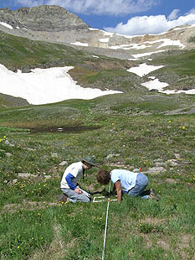
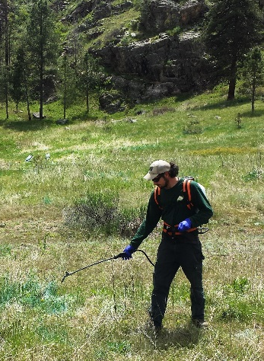
National Environmental Policy Act of 1974*
Laws & Regulations
Process
Involve the public & stakeholders
Considering all the effects
Purpose and Need for the action
Design the preferred alternative
Identify issues
Reasonable range of alternatives
Effects from actions proposed
Prepare a document
(Environmental Impact Statement, Environmental Assessment)
Categorical Exclusion (Policy Directive)
Public Comment
Regulatory Agency
Council for Environmental Quality
Federal Courts
Litigation
Precedence
Photo Credit Center
for Snow & Avalanche Studies
Policy Directives
GET INVOLVED!
EFFECTS include
Direct, Indirect, Cumulative
Interdependent, Interrelated
Decision Makers
Complexity of the alternatives
Magnitude of the effects

Slide 5
Definitions
Endangered –
Threatened-
Proposed-
Critical Habitat-
danger of extinction throughout all or a significant portion of its range; NOT Class Insecta
become an endangered species in the foreseeable future throughout all or a significant portion of its range
Section 4 Determination of endangered species and threatened species; was petitioned for listing, was reviewed and found warranted and is being considered for listing as threatened or endangered (Federal Register)
specific areas within the geographical area occupied by the species, at the time it is listed with physical or biological features (I) essential to the conservation of the species and (II) which may require special management considerations or protection; and (ii) specific areas outside the geographical area occupied by the species at the time it is listed that are essential for the conservation of the species.
Litigation
Candidate-
Sensitive-
Endemic-
Section 6 Cooperation with the States; petitioned for listing and is under review to determine if it is warranted or not; NOT PROTECTED
Agency derived at the Regional Office level based on review of data and best available science; populations show a significant current or predicted downward trend in species population numbers, densities or habitat capability reducing species distribution
restricted range or distribution
Special Status Species – (BLM) threatened, endangered, proposed, sensitive, candidate

Slide 6
Legal Responsibility With Federal Nexus
Status of Species
Law or Regulation
Who Complies
Regulating Agency
Threatened
Endangered
Proposed
Critical Habitat
US Fish & Wildlife Service
National Oceanic & Atmospheric Administration: Fisheries
Federal Action Agencies
Federal Contractors
Federal Partners
Federal Permit Holders
Public Lands Visitors
Protected by the Endangered Species Act
Addressed BUT NOT PROTECTED by the Endangered Species Act
Federal Action Agencies
Federal Contractors
Federal Partners
Federal Permit Holders
Public Lands Visitors
Candidate
Sensitive
Federal Action Agencies
State Agency - CPW
Land & Resource Management Plans (Forest Plan)
Resource Management Plan (BLM)
Federal Action Agencies
State Agency- CPW
Federal Action Agencies
Federal Contractors
Federal Partners
Federal Permit Holders
Public Lands Visitors
Endemic

Slide 7
Legal Responsibility NO Federal Nexus
Status of Species
Law or Regulation
Who Complies
Regulating Agency
US Fish & Wildlife Service
National Oceanic & Atmospheric Administration: Fisheries
Threatened
Endangered
Proposed
Critical Habitat
Protected by the Endangered Species Act
State Agencies
Counties
Private landowners- limited
Candidate
Sensitive
Addressed by the Endangered Species Act
State CPW- limited
State Agency - CPW
Land & Resource Management Plans (Forest Plan)
Resource Management Plan (BLM)
State CPW- limited
State Agency- CPW
Endemic

Slide 8
Endangered Species Act: Threatened, Endangered, Proposed Species, Critical Habitat
Federal Nexus (E.g. grant $, land, etc.)
Section 7 Interagency Cooperation
No Federal Nexus
Section 6 Cooperation with States & Section 9 Prohibitive Acts
Proposed Action
Inventory
Proposed Action
Inventory, Analysis
Section 7 Consultation, Biological Opinion
Implement & Monitor
Communicate
Federal Decision
Implement & Monitor
Adverse, Section 9 & Section 10 Take Permit
Revise Proposal
Adverse, Section 9 & Section 10 Take Permit
Take = “to harass, harm, pursue, hunt, shoot, wound, kill, trap, capture, or collect or attempt to engage in any such conduct.”
Listed plants are not protected from take, although it is illegal to collect or maliciously harm them on Federal land.
The ESA does not protect plants unless there is a Federal nexus.
ASSUMPTIONS: If do not inventory, must assume presence

Slide 9
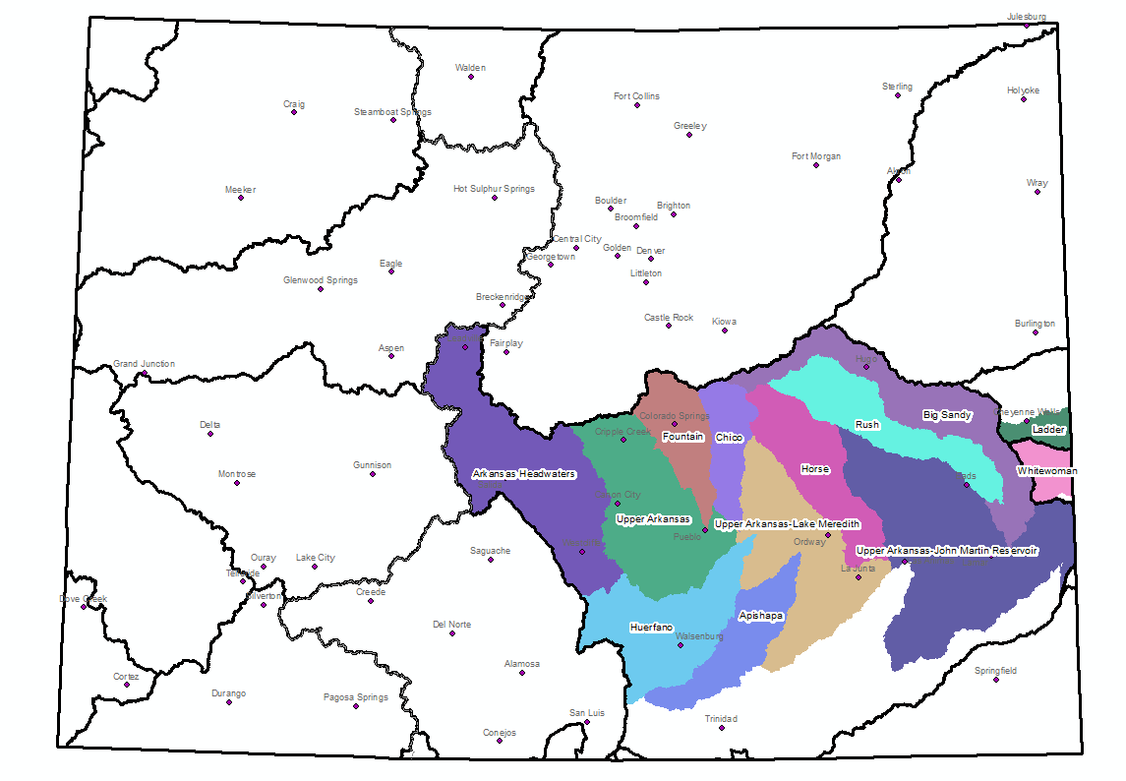
Special Status Species
In the
Arkansas River Watershed
Leadville to Pueblo

Slide 10
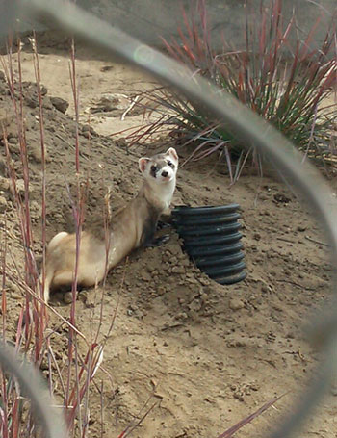
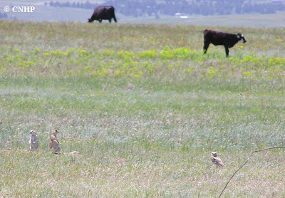
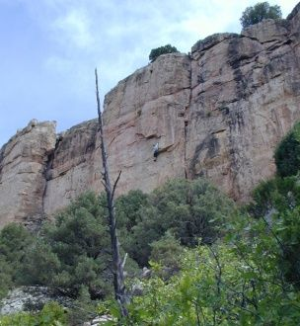
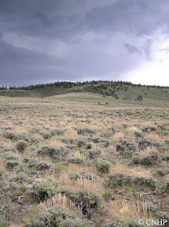
Endangered Species Act: Threatened, Endangered, Proposed Species, Critical Habitat
Lower Valley Upland Environments
Rocky Canyon Environments
Gunnison sage-grouse T
Black-footed ferret E
Mexican spotted owl T
Designated Critical Habitat for MSO
Photo Credit Colorado Natural Heritage Program
Photo Credit US Fish and Wildlife Service
Photo Credit Bureau of Land Management
Photo Credit Colorado Natural Heritage Program

Slide 11
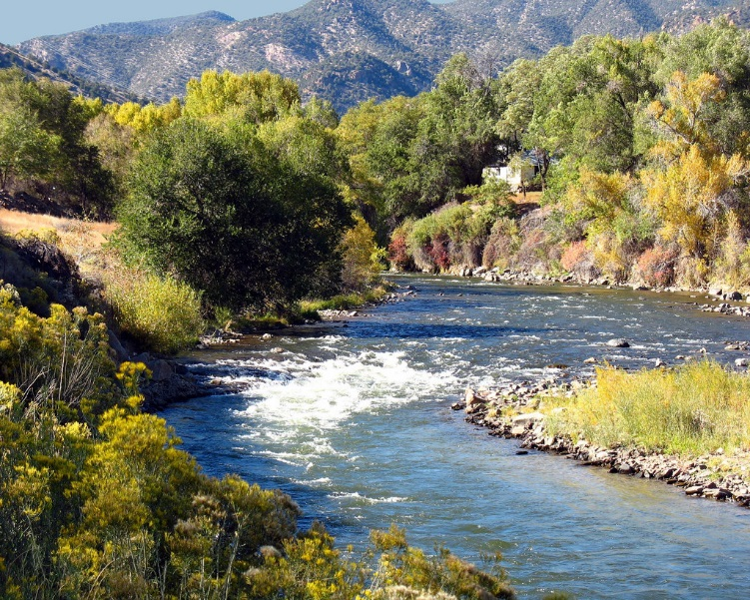
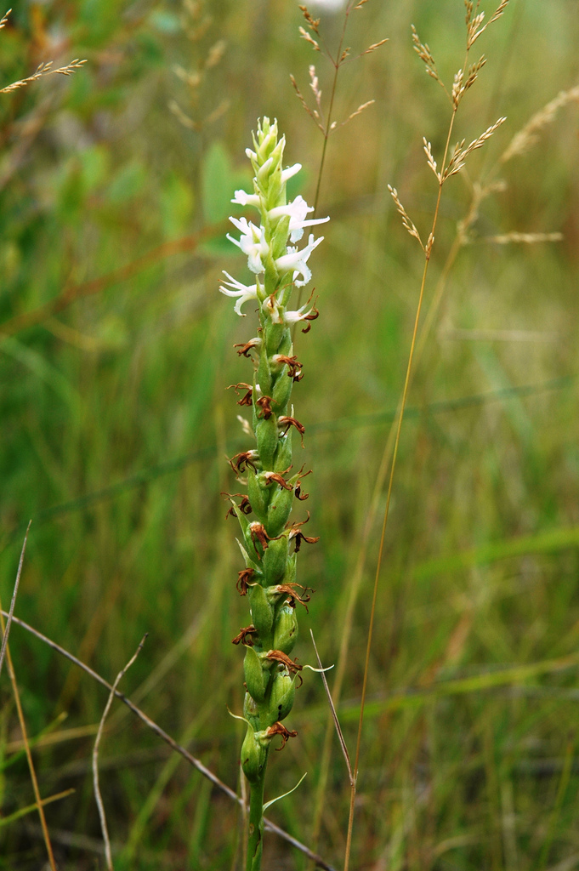
Endangered Species Act: Threatened, Endangered, Proposed Species, Critical Habitat
Wetlands, Fens, Riparian Corridors, Sites
Within ½ mile of Arkansas River, Perennial Tributaries
Spiranthes diluvialis Ute ladies’-tresses orchid T
Platanthera praeclara Western prairie fringed orchid T
Prebles’s meadow jumping mouse T
Southwest willow flycatcher E
Whooping crane E
Piping plover T
Least tern E
Greenback cutthroat trout T
Humpback chub E
Bonytail chub E
Colorado pikeminnow E
Razorback sucker E
Pallid sturgeon E
Arkansas darter C
Photo Credit Carol
Photo Credit: Bekee Hotze USFWS

Slide 12
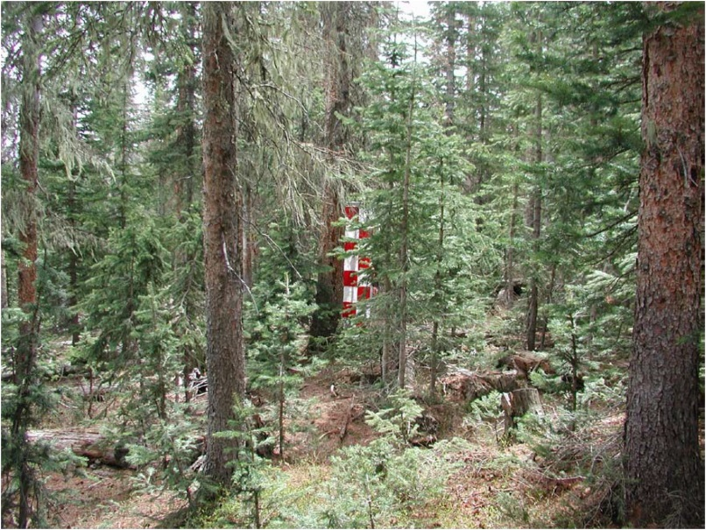
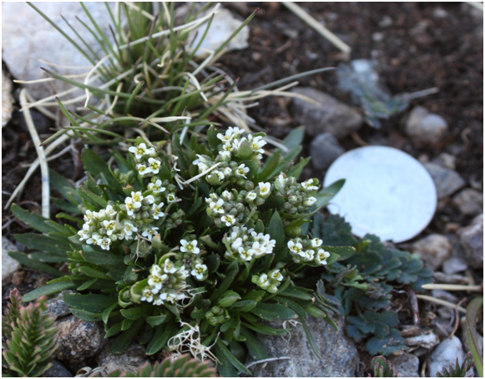
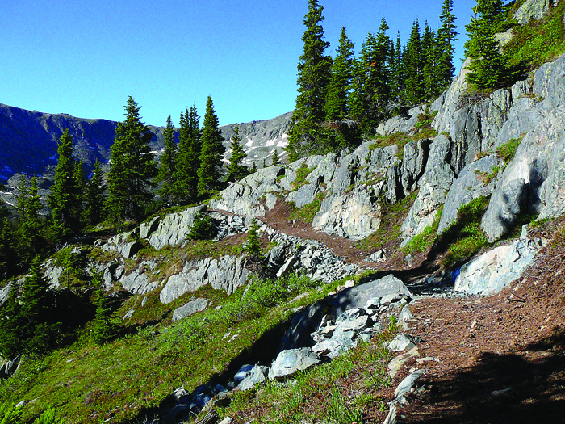
Endangered Species Act: Threatened, Endangered, Proposed Species, Critical Habitat
Subalpine Environments
Canada lynx T
Alpine Environments
North American wolverine proposed T
Eutrema penlandii Penland alpine fen mustard T
Uncompaghre fritillary butterfly E
Photo Credit Doug Clark Rio Grande National Forest
Photo Credit Park County Trust
Photo Credit Mal Sillars Chaffee County Times

Slide 13
Policy Directives
Sensitive Species
Forest Service Manual 2670 Threatened, Endangered
and Sensitive Plants and Animals (2005)
BLM Manual 6840 Special Status Species
Management (2008)
US Forest Service Region 2 Sensitive Species
5 amphibians
2 reptiles
19 fish
8 insects
31 birds
19 mammals
87 plants
3 molluscs
Western bumble bee (Bombus occidentalis)
Monarch butterfly (Danaus plexippus plexippus)
BLM Colorado Sensitive Species
5 amphibians
4 reptiles
9 fish
I insect
14 birds
11 mammals
67 plants
0 molluscs
Unique Environments
Soils
Cliffs
Barrens
Wetlands
Fens
Riparian
Species Viability
ESA, NFMA, etc.: Cannot trend towards listing

Slide 14
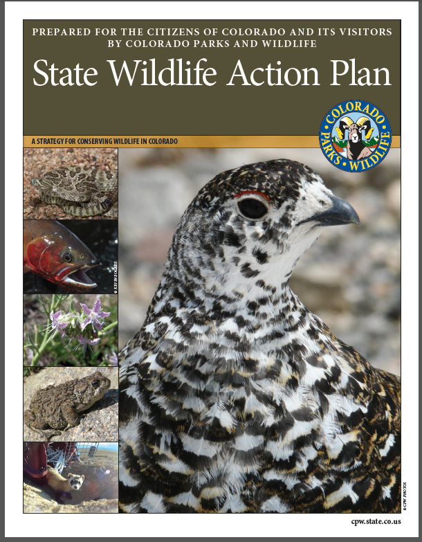
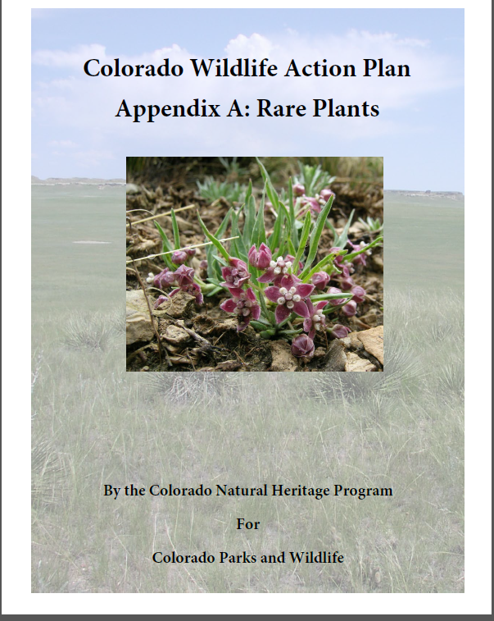
Species Listed by the State of Colorado
Non-Game Wildlife
§ 24-4-103, C.R.S., and the state Wildlife Act, §§ 33-1-101 to 33-6-209, C.R.S.
Focus on Take
State Endangered
State Threatened
State Special Concern (not a statutory category)
Colorado's State Wildlife Action Plan
Not regulation
Not a recovery plan
Conservation practices- consistency, actions
For everyone
Partnership building
Project design
Implementation
Approval from the US Fish and Wildlife Service
http://cpw.state.co.us/Documents/CNAP/rareplant_SWAP_2015_final_sept9.pdf
http://cpw.state.co.us/aboutus/Pages/StateWildlifeActionPlan.aspx

Slide 15
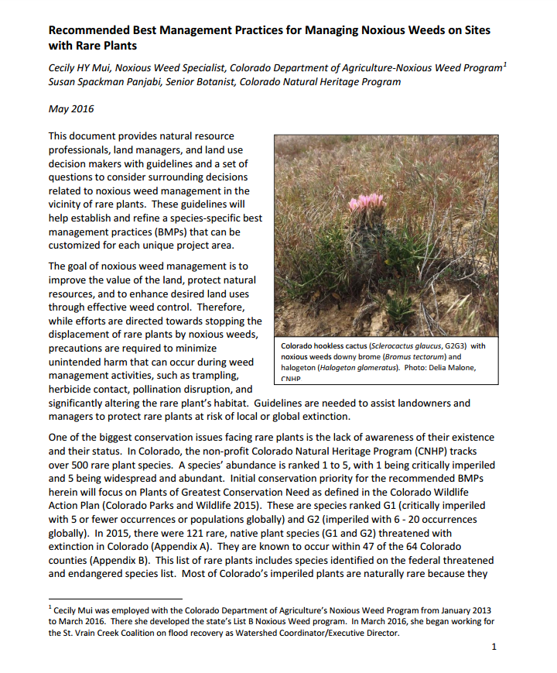
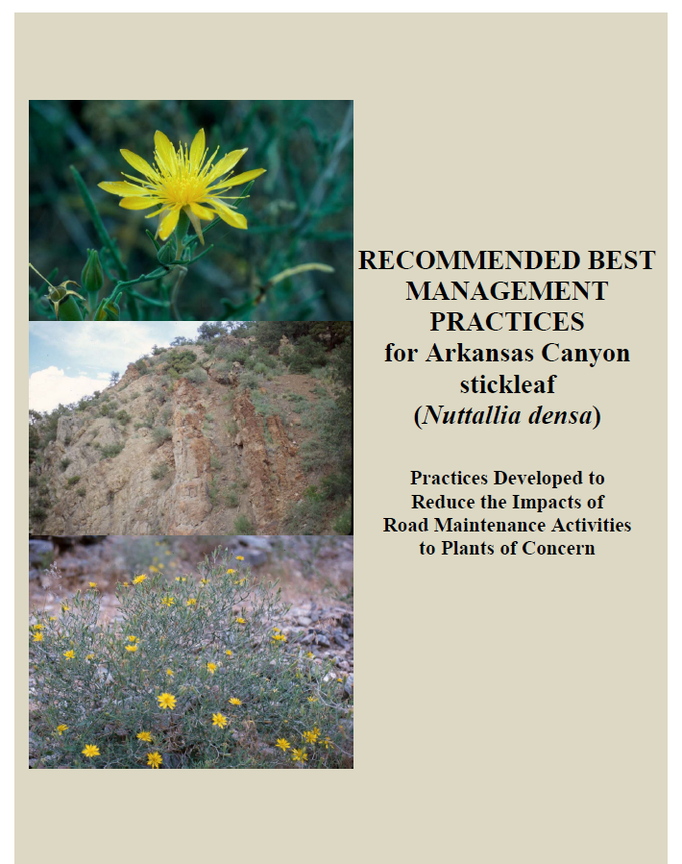
Reproduction
Timing
Where are breeding
Solitude/Territoriality
e.g. northern goshawk nest abandonment
Niches
Resources (food, water, etc.)
Pollinator dependency
Key habitats
e.g. Rocky Mountain bighorn sheep & open cliffs
Contamination
Travel pathways
Equipment and gear
e.g. boreal toad and Chytrid fungus
Chemical Sensitivity
Direct application
Drift
Prey
e.g. bald eagle and DDT
Best Management Practices
V
I
A
B
I
L
I
T
Y
Noxious Weeds are a Treat
Treatment Methods Can be a Threat Too
http://www.cnhp.colostate.edu/download/maps.asp
Viability - consisting of self-sustaining and interacting populations that are well distributed through the species’ range. Self-sustaining populations are those that are sufficiently abundant and have sufficient diversity to display the array of life history strategies and forms to provide for their long-term persistence and adaptability over time

Slide 16
Best Management Practices
Early Detection
Early Coordination
Collaborative & Appropriately Rapid Response
Monitor, Maintain & Adapt

Slide 17
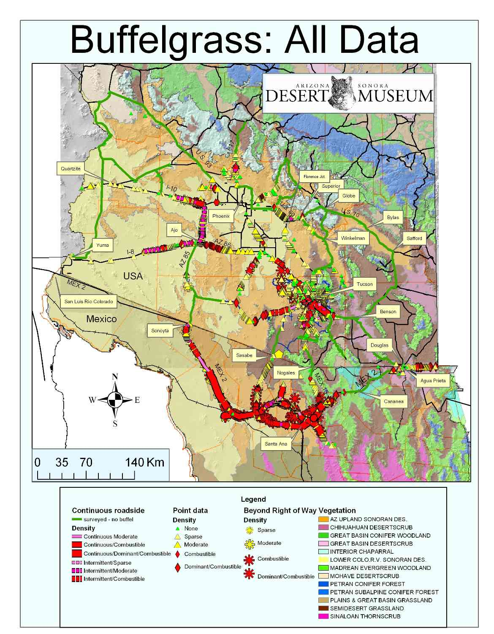
Early Detection
Best Management Practices
“But I had no idea.”
Inventory & Map
Accuracy is important
Scale is relevant
Share the data
Environment characteristics
List special status species
List noxious weeds
Accurate identification
Voucher specimen collection- specialist
Use a variety of databases
Maintain variety of databases
*
Photo Credit Invaders of the Sonoran Desert Region

Slide 18
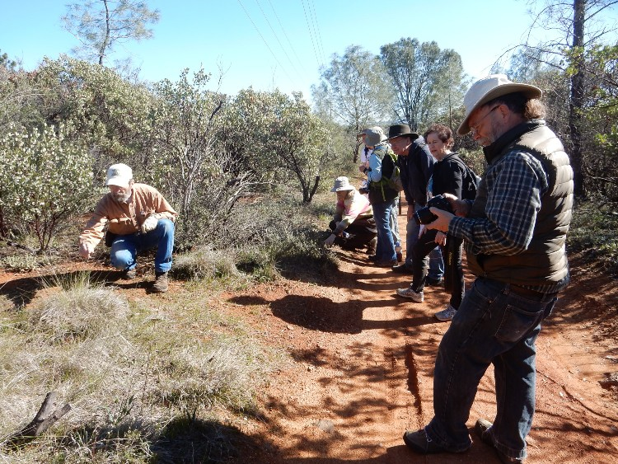
Early Coordination
Best Management Practices
Consult specialists
Contact agency
Laws, regulations, policy compliance
Land uses
Goals
Assess risk of that weed population
Consequences- long and short term; irreversible, irreplaceable
Photo Credit California Natural Heritage Program
Ask questions!
“Is the NEPA decision document signed?” “Can I get a copy?”
“What inventories are needed?”
“Are inventories complete?”
“What did the inventories find?”
“What conservation measures are required? Recommended?”

Slide 19
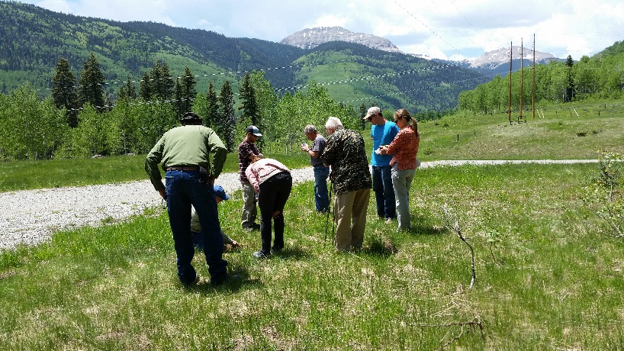
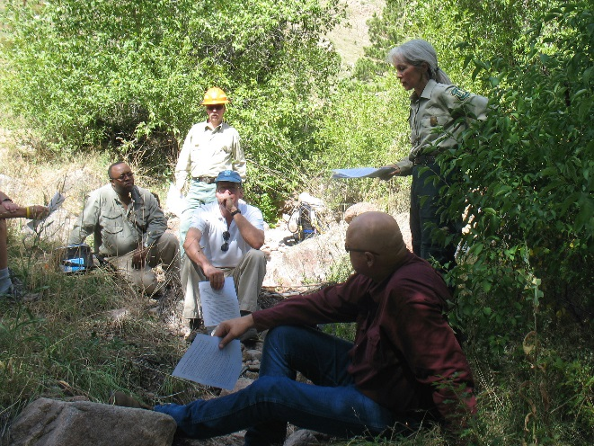
Collaborative & Appropriately Rapid Response
Best Management Practices
Coordinate the response
Maintain flexibility
Avoid or remove sources of weed seed and propagule
Prevent or minimize the need when and where feasible
Include prevention actions in project layout, design, alternative evaluation, and project decisions
Use effective nonchemical methods
Modify tools when feasible
Allow for various timeframes when possible
Plan for a wide variety of equipment, methods or techniques
Use adaptive management language (contracts, agreements, grants)
Oxeye Daisy site Review San Juan Cooperative Weed Management Area
Noxious Weed Interagency Meeting Spruce Gulch

Slide 20
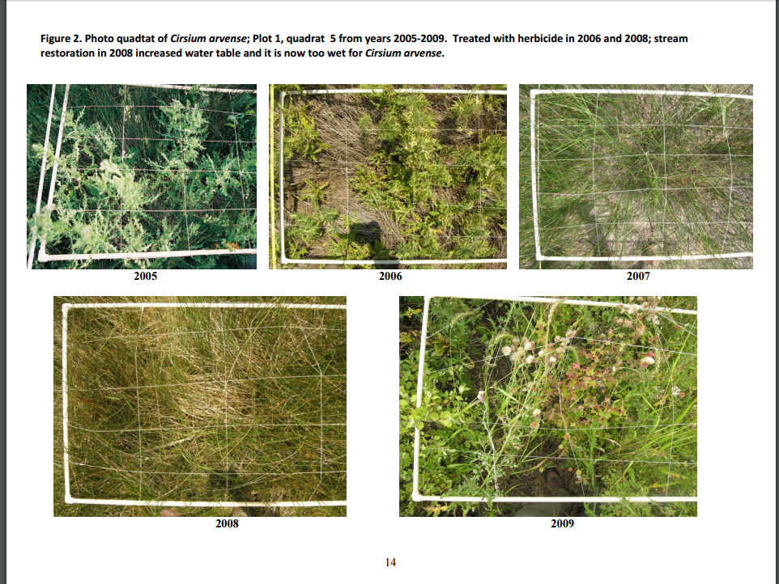
Monitor, Maintain & Adapt
Best Management Practices
Coordinate monitoring
Monitor weed response- defensible
Monitor effects- defensible
Short and long term consequences
Collaboration
Data & databases
Use adaptive management approach
Share lessons learned
Photo Point Monitoring
US Forest Service
Noxious Weed Monitoring at the US Air Force Academy – Year 5 Results
Colorado Natural Heritage Program

Slide 21
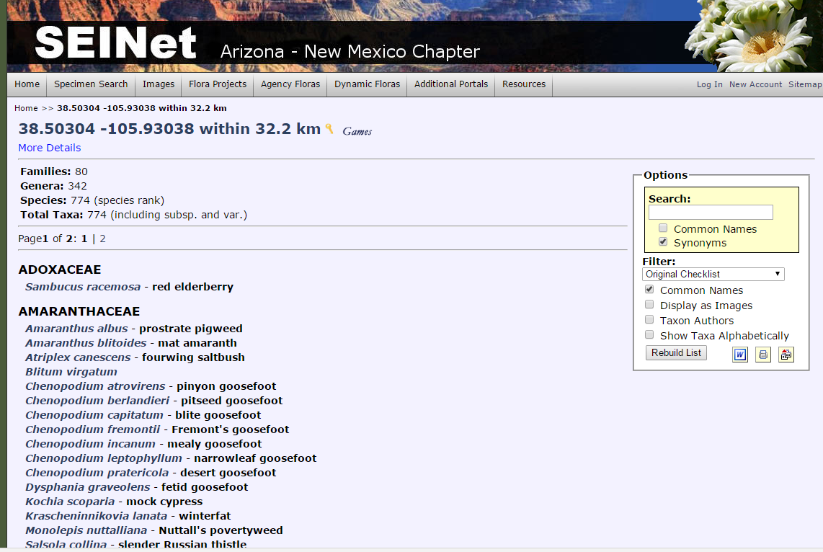
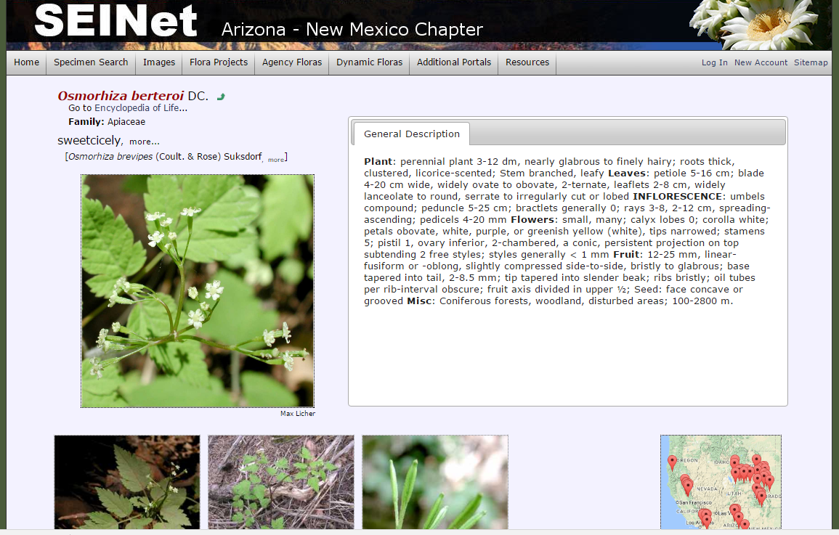
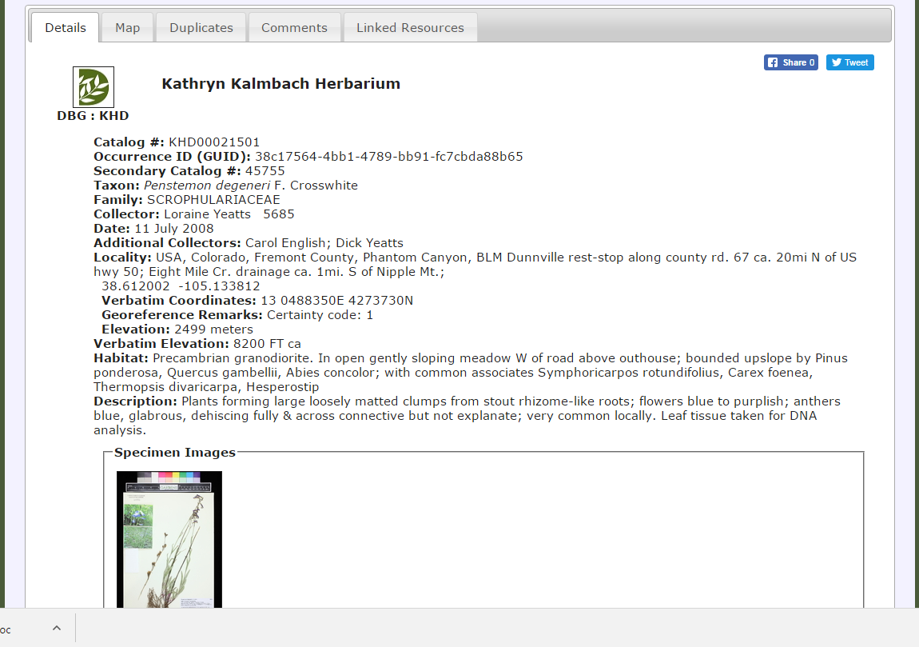
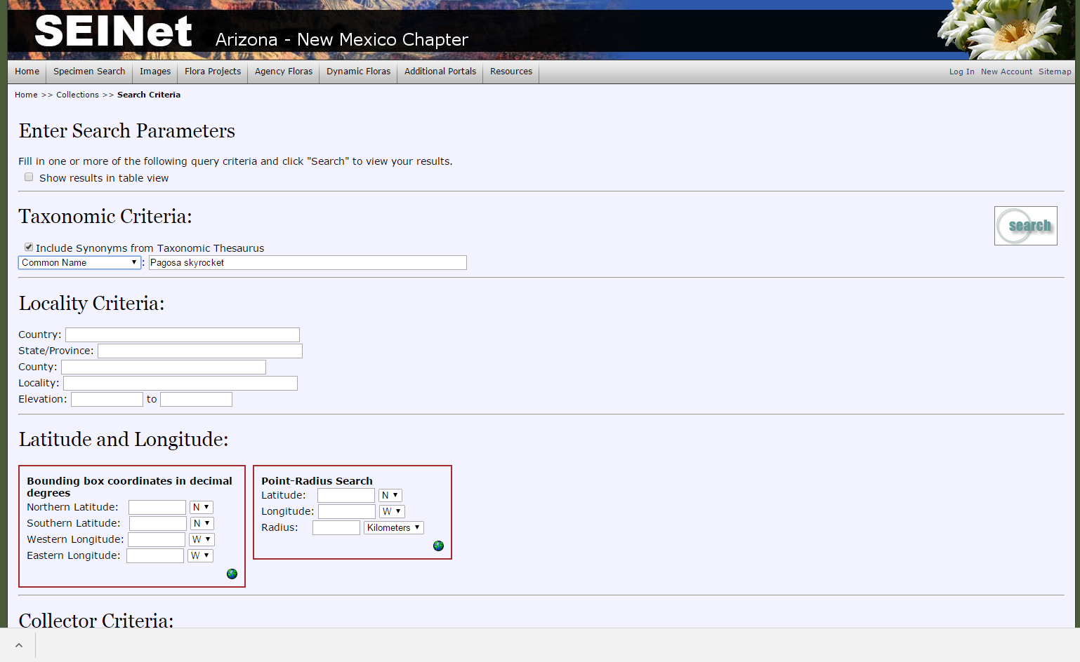
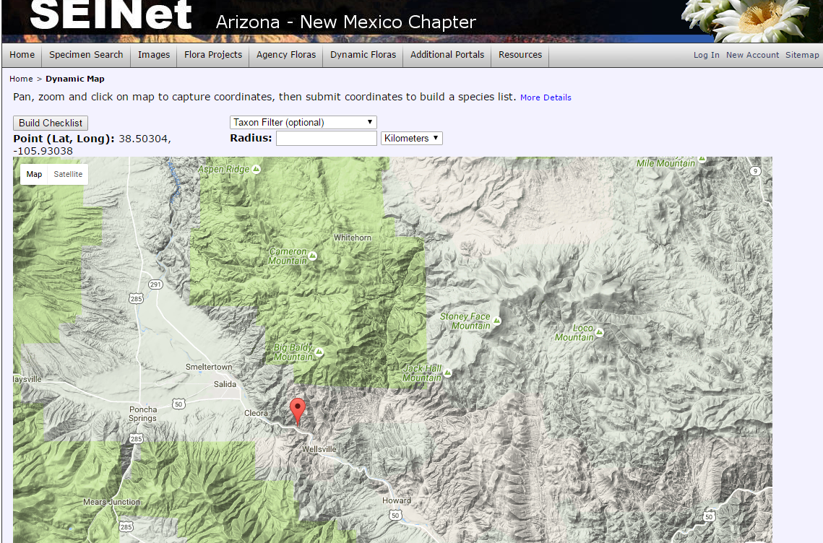
For Future Reference
Herbaria Online!
SEINet http://swbiodiversity.org/seinet/collections/index.php
Dynamic Checklist

Slide 22
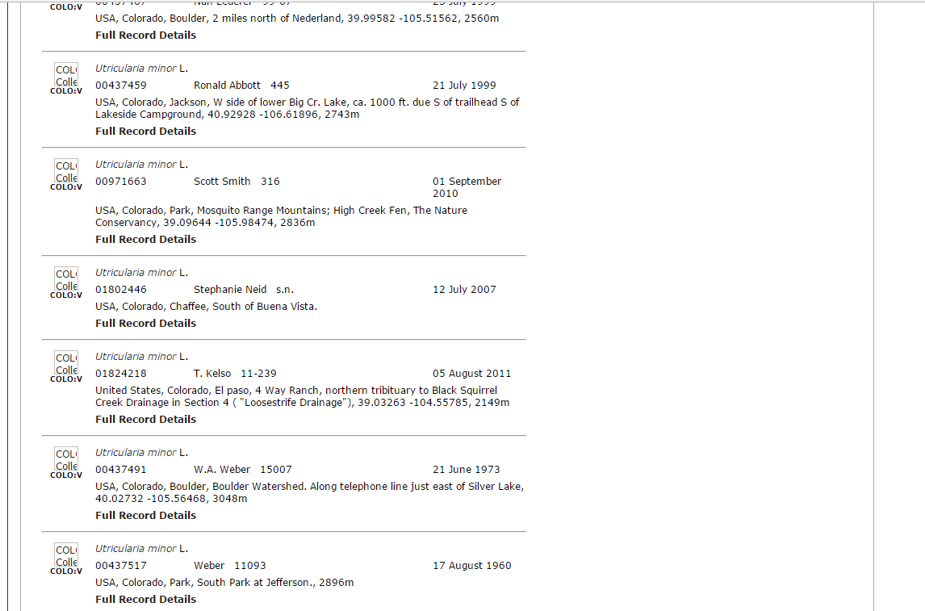
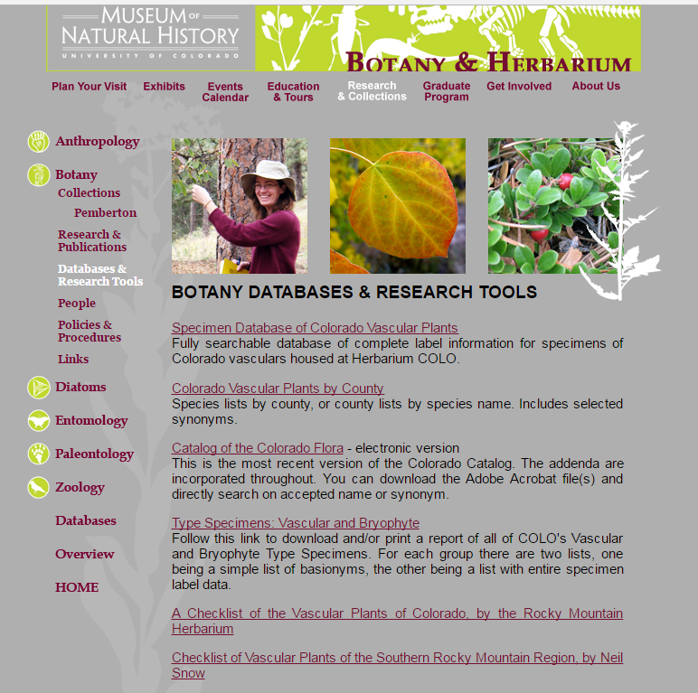

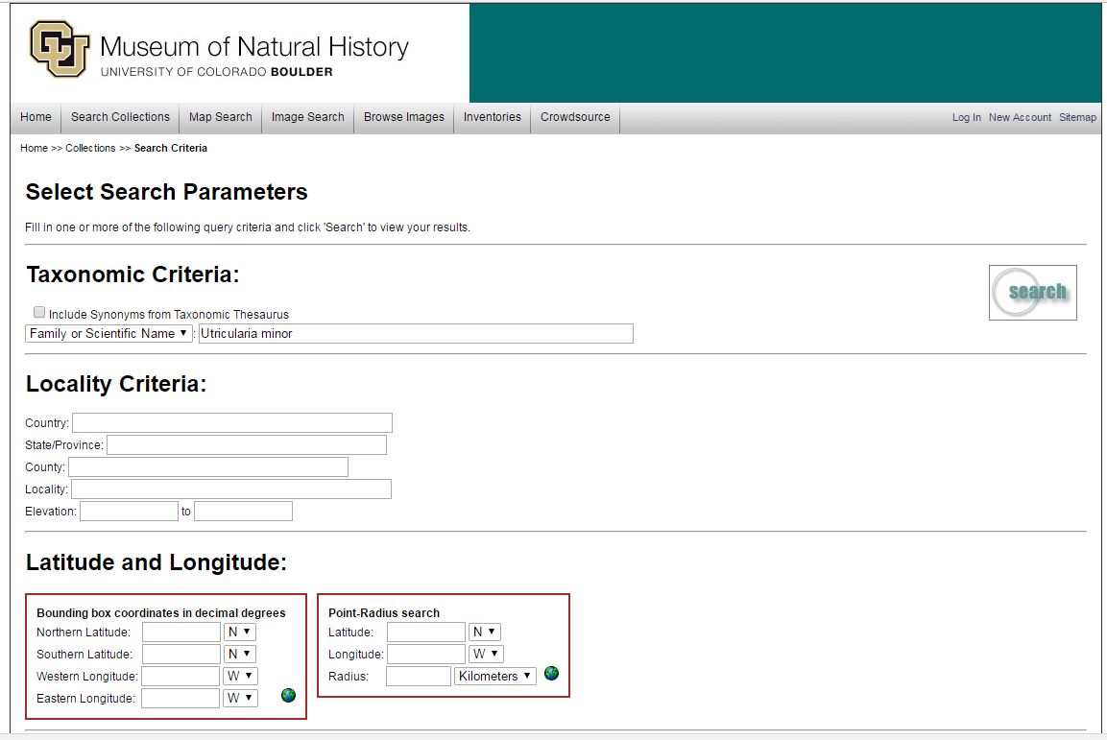
For Future Reference
Herbaria Online!
University of Colorado https://cumuseum-archive.colorado.edu/Research/index.html
Herbarium
Zoology
Etc.

Slide 23
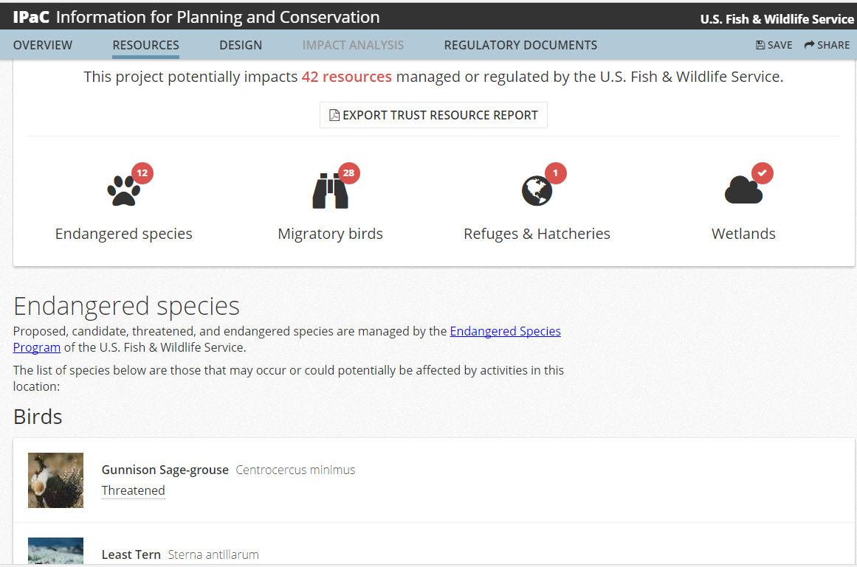
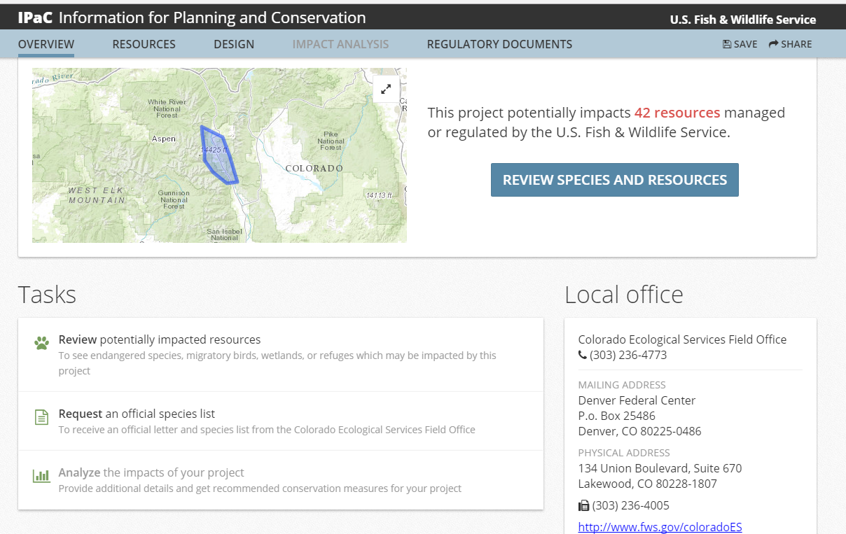
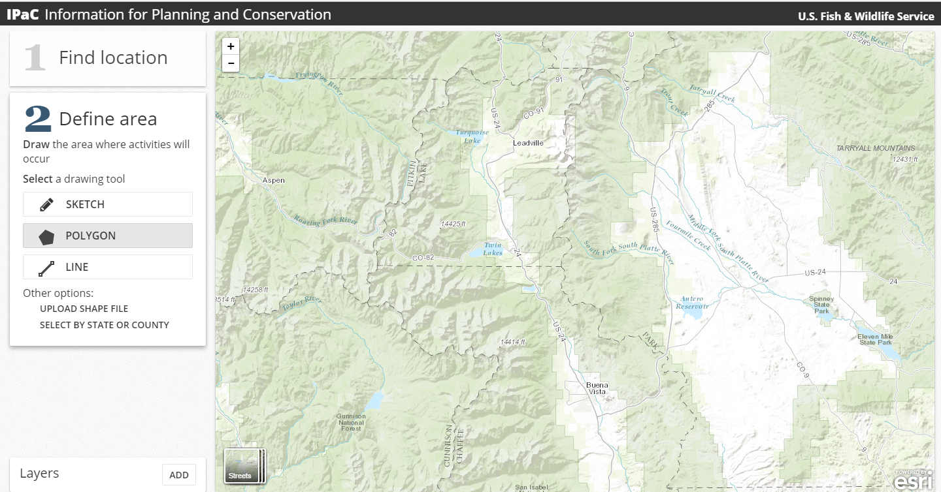
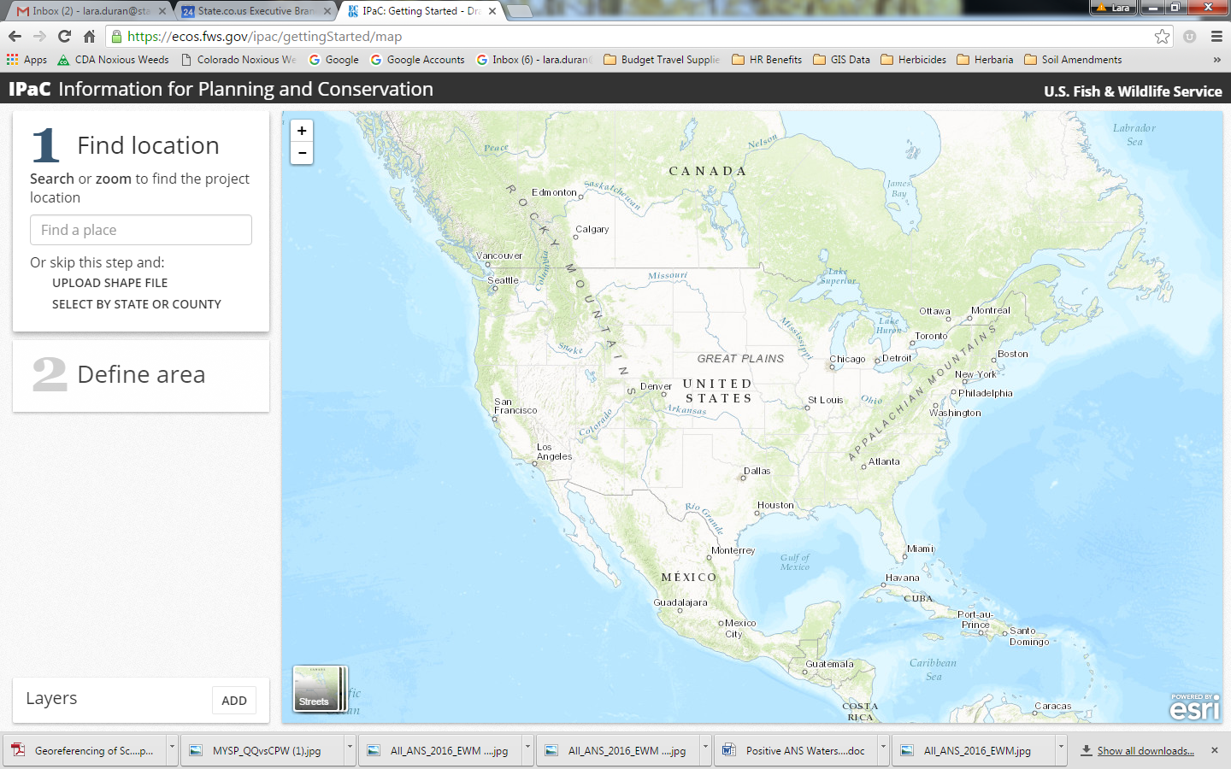
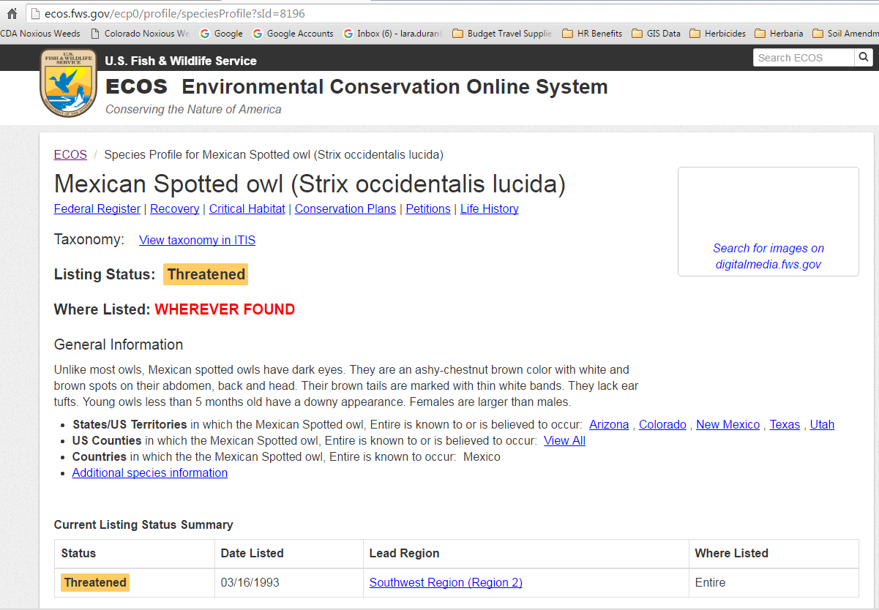
For Future Reference
Overall list of TE&P Species
USFWS https://ecos.fws.gov/ipac/

Slide 24

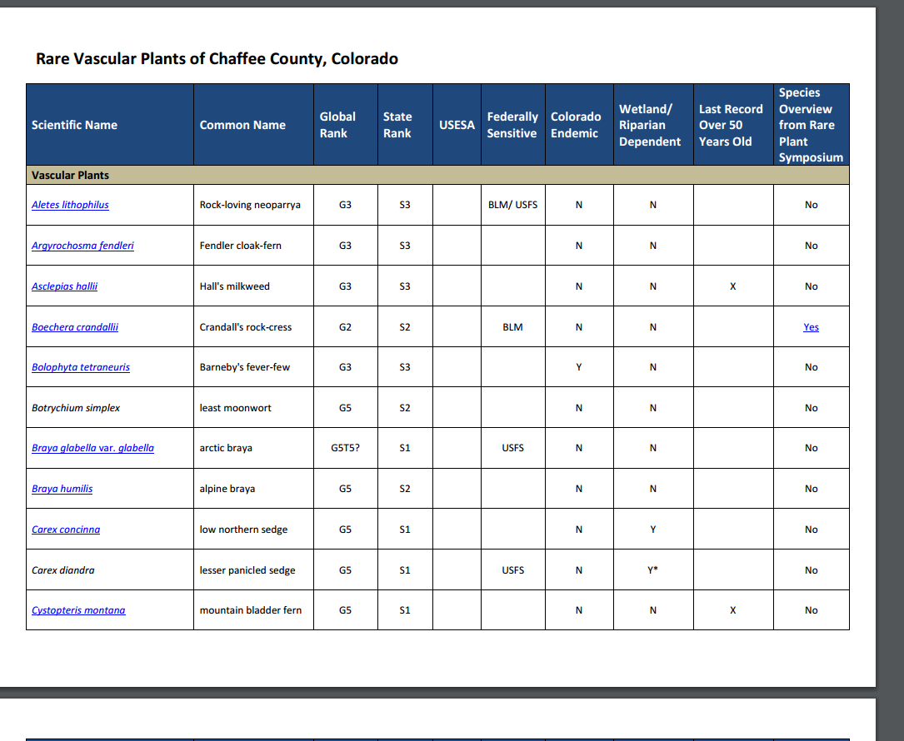
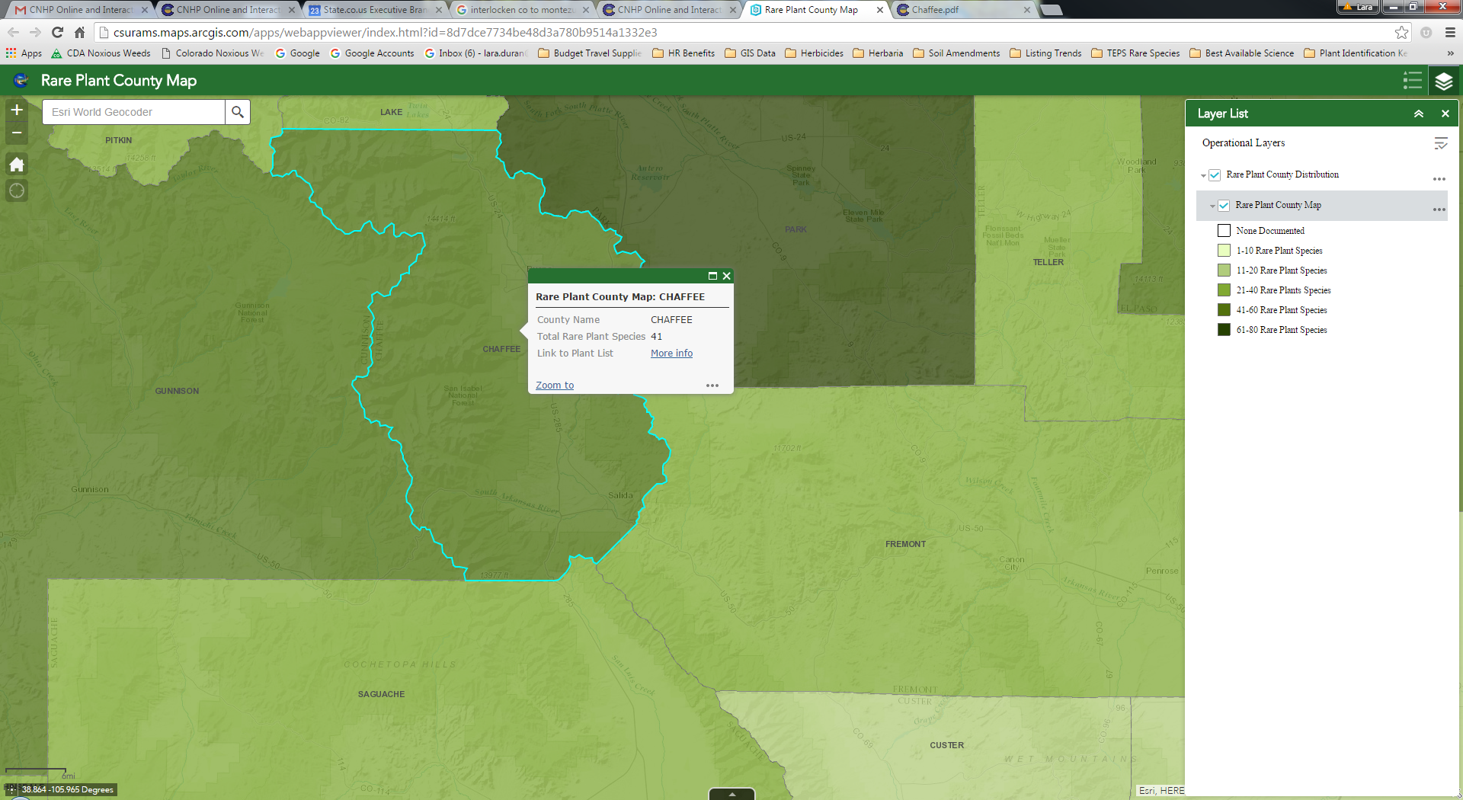
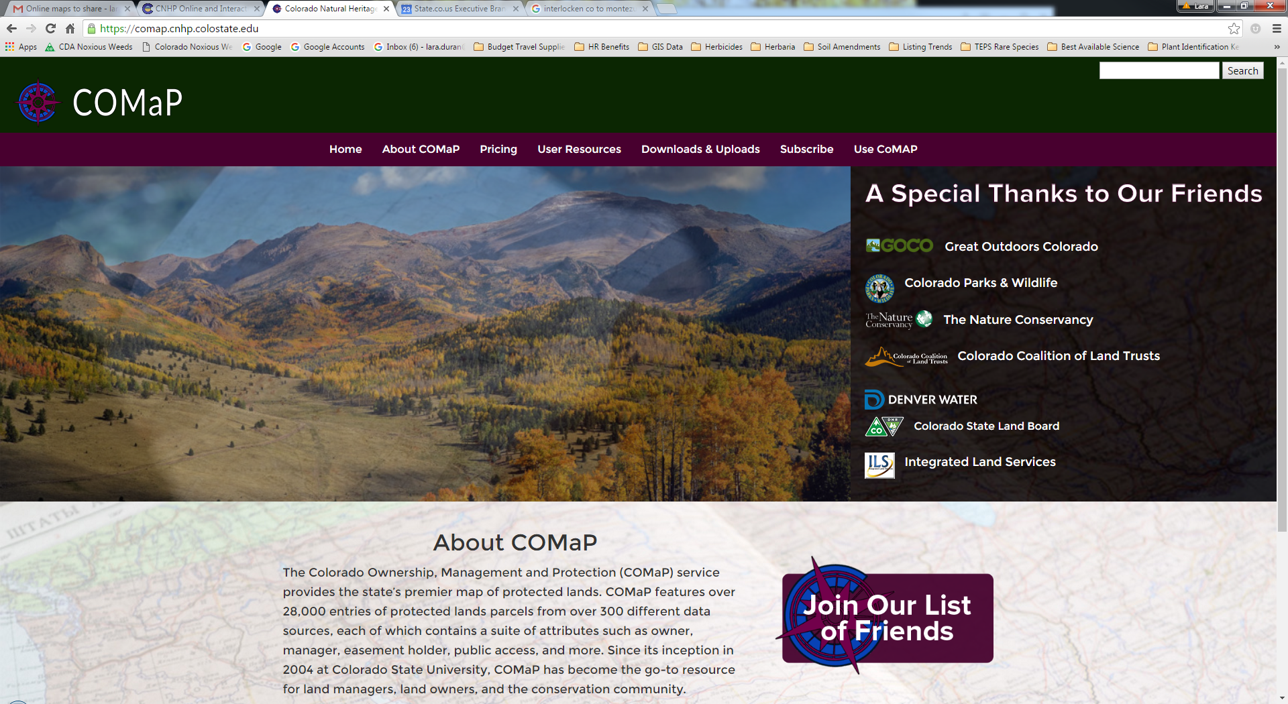
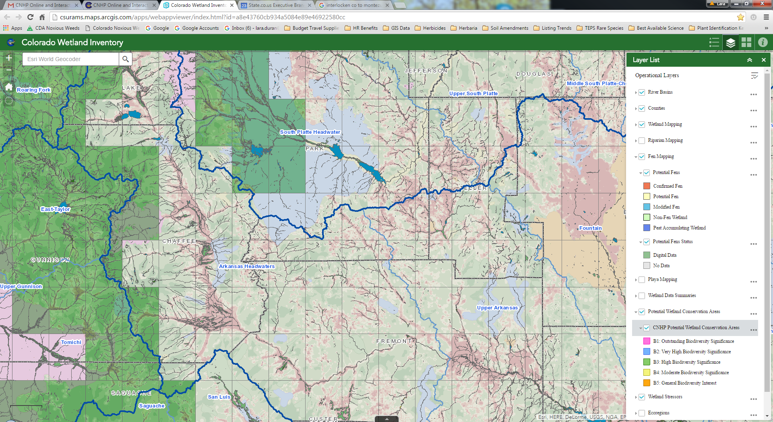
Rare Plant Identification Confirmation
CO Natural Heritage Program
CNHP@colostate.edu
(970) 491-7331
For Future Reference
CO Ownership Mgmt Map
CO Wetland Inventory
CO Rare Plants by County
CO Rare Plant Guide
Rare plant symposium
September
CO Native Plant Society
http://www.cnhp.colostate.edu/download/maps.asp

Slide 25
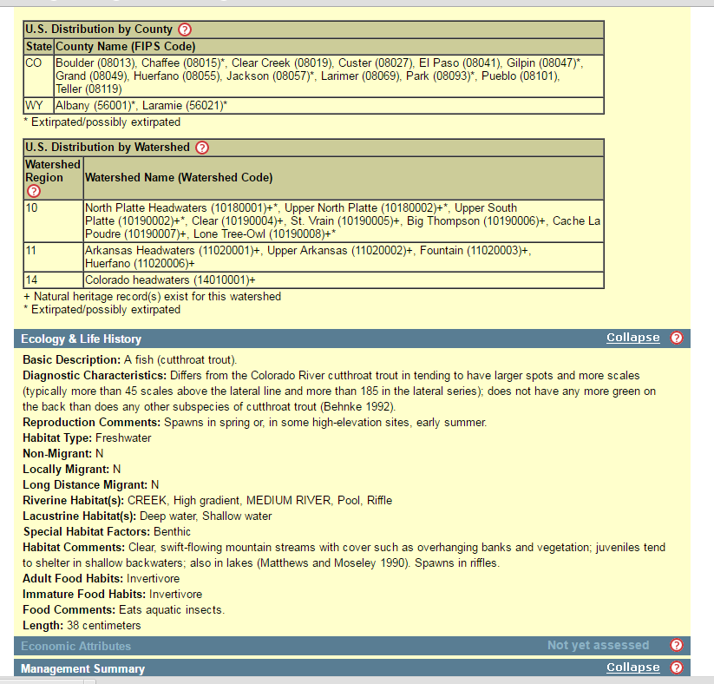
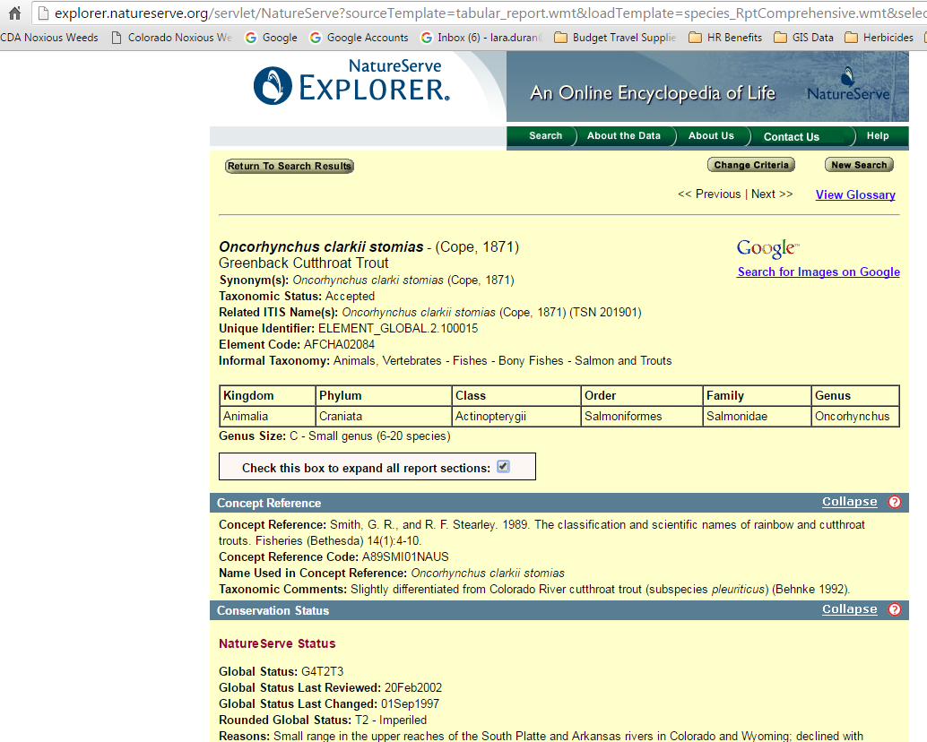
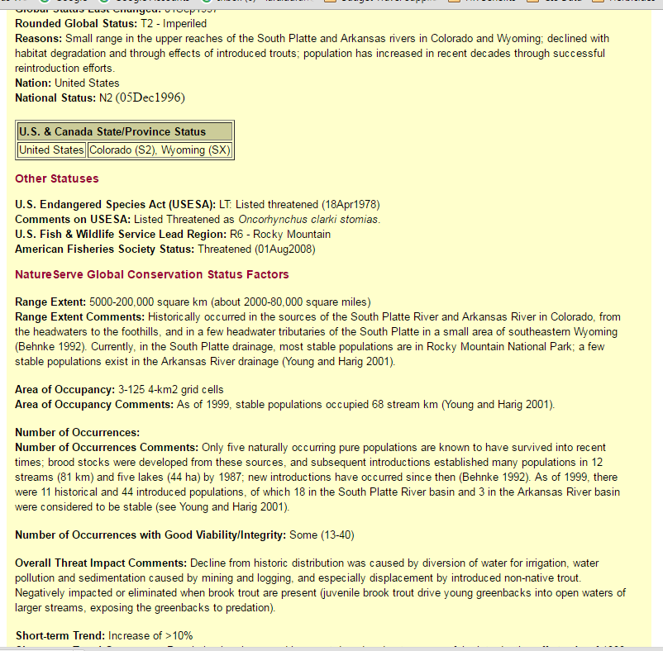
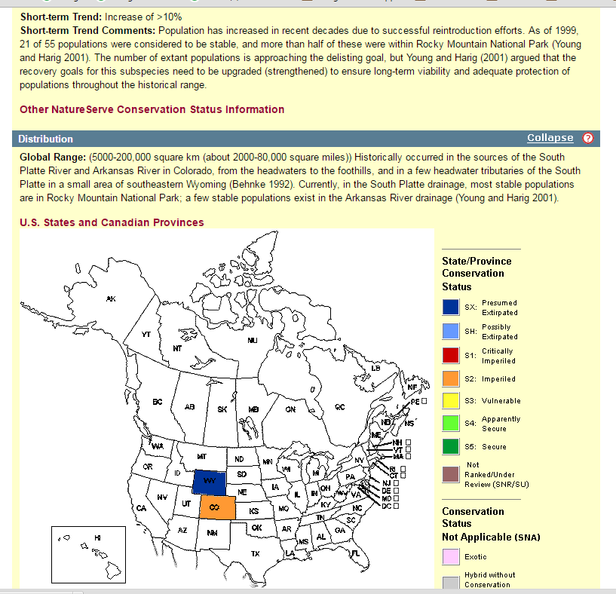
For Future Reference
NatureServe Explorer
Spelling counts!
http://explorer.natureserve.org/

Slide 26


For Future Reference
List of Sensitive Species & On/Bordering NFS
US Forest Service, Pike San Isabel National Forest
Steve Olson Botanist 719-553-1519
Mike Welker Biologist 719-553-1515
List of Sensitive Species & On/Bordering BLM
BLM Royal Gorge Field Office
719-269-8500
blm_co_info@blm.gov
Pawnee montane skipper on host plant Liatris punctata

Slide 27

For Future Reference
TE&P Wildlife on Private Lands
CO Parks and Wildlife
(719) 530-5520
Colorado State University Extension Office
Native Plant Master Program- Pueblo
Sherie Caffey
719-583-6566
Rare Plants on Private Lands
CO Parks & Wildlife Natural Areas Program
Raquel Wertsbaugh 303-291 7267
raquel.wertsbaugh@state.co.us ​​
Colorado Native Plant Society
conpscturner@gmail.com
Arkansas Valley Audubon Society
arkvalleyaudubon@gmail.com
Natural Resource Conservation Service
Patty Knupp
719-543-8386 x112
Patty.knupp@co.usda.gov
Hesperis matronalis Dame’s rocket

Slide 28

For Future Reference
Lara Duran
List B Specialist
303-869-9036 lara.duran@state.co.us
Patty York
EDRR Specialist
303-869-9035
Patty.York@state.co.us
Steve Ryder
State Weed Coordinator
303-869-9034
Steve.ryder@state.co.us
Centaurea diffusa x psammogena Diffuse x spotted knapweed hybrid?

